Slide 1
Summer school “Social work in diverse communities” 09.08.2023. – 11.08.2023. II. Inspiration. What do I want to change? How and with whom I will make this change? The framework for community work: legislation, methods, current researches Eeva – Mari Miettinen – Senior Lecturer, Social Services and Health Care Joonas Kiviranta – Leading community social worker. The wellbeing services county of Pirkanmaa
European Union Cohesion Policy Programme 2021-2027 European Social Fund Plus Measure 4.3.5.4
project "Development of professional and modern social work"

Slide 2
Session II
Inspiration

Slide 3
The elements and competencies of community social work
Relationship-based social work and horizontal relationships between the agents
Sense of community and community-based social work
Experimentation and shared action for social change
Creativity and analytical thinking
Moral courage practice

Slide 4
”Informality within formality” ”Working close and together ’’

Slide 5
Relationship-based social work
From that first encounter, the process of creating a relationship and trust begins. Trust ought to come before constructing social problems. It is central to avoid normalizing power (Foucalt 1980). Trust before problems.
The individual, organizational and community levels, three dimensions of the relationship
Uncertainty – Unpredictable – Exposed to conflicts
Informal environment helps to build trust with both the individual and the community as social agent.
An environment that helps deconstruct power relations between workers and service users. Professional workers’ ability to create informal relationships was a vital element in promoting equality and building trust. Informality means sharing power and responsibilities by working together
Open dialogue vs interrogation

Slide 6
Sense of community and community-based social work
And this is where we are now, with these people. We understand better the environment, the situation and those people, so we start to change our position towards that direction. We start to use the law and the means that exist, to make that change. And that's structural social work, if anything. And it combines community social work with structural social work. This changes, community social work changes those perceptions of reality, and structural social work is that change.
( Community Social worker, 2021 )

Slide 7
Sense of community and community-based social work
Involving the community is the key to success. Always say yes and then think how.
Social work is not the only source and not alone responsible for social activity.
Seeing the capabilities in the community creates new measures and resources for social work
Shared needs require a shared effort to find shared solutions. Visible, active and concrete participation - participation is tangible, not tokenistic involvement.
Shared ownership, shared problems. Sensitivity and instant reaction of values of equality, discrimination or openness are challenged.
Early intervention, open dialog and structured meetings with the active members and organizations of the community

Slide 8
Experimentation and Shared Action for Social Change
Current knowledge and information. From the unofficial to official and reversed.
Shared actions create shared thinking.
Inviting other official organizations or institution work when needed. Shared environment makes it possible to try out a more inclusive community-based and needs-based way of working and, more importantly, take the lessons learned back to their parent organizations. What is more, it gives a face to an otherwise faceless institution.

Slide 9
Creativity and Analytical Thinking
Active collaboration with the university, researchers, and student practitioners, helps to promote critical reflection and analytical thinking. Living lab.
Safe atmosphere to openly discuss doubts and uncertainties.
The freedom and space. Attempts are encouraged, mistakes are accepted, and immediate success isn't required.
Open for analytical processing and critical reflection on actions and choices.
Learning process. Instead of being restricted by managers, just give it a go. Try it, ditch it, develop it.

Slide 10
Some conclusions
Working close to people and close to the statutory social work institution.
‘Travelling competence' that followed these social work practitioners and can now be seen in their office-based statutory work in immigrant social services. The transformation includes a broadened understanding of how to support the integration process by providing different tools and community resources to support individual's self-efficacy and ownership of their own lives.
Social work competencies were transformed in the process of collaborative learning and dialogical social development.
The development of competencies demanded personal courage and self-efficacy, and above all, trusting that skills and resources will be found within the community. It demanded that the practitioners cope with challenging situations without knowing the final answer.
Create the change from the inside of the public sector
Based on the local needs of the area and its people
Learning through experiences and interaction
Re-designing the given institutional reality into this new arena made it possible to create an alternative and more positive way of seeing the users of these service
Visitors, residents, and actors or clients, customers and service users?
Know the community, pop-up will not work.
Moral courageous practice:
Moral courage in social work is called for as a collective matter instead of a matter of individual morality. Moral courage is not expressed and acted in a monophony: it is a result of a dialogue that has been engaged either with existing people or a dialogue that has been had with the moral self imagined > Similarly, the act of moral courage is not a lonely performance: the ethical foundations of social work function as a negotiator (Pekkarinen, forthcoming)

Slide 11
BREAK

Slide 12
Methods – Who? How? and under what conditions?
Community social work center
Community advisors
Drop - in centers
Outreach social work

Slide 13
Method: Community social work center
Community Center
Low threshold and accesible
Living lab for social innovations
Concrete place, not a website/app makes co-operation possible
Visitors and residents
Community advisors, experts by experience, volunteers
Community assessors, neighborhood democracy
Public sector
Leading the process and funding facilities
The structure and coordination for multidisciplinary co-operation
Possible to use official means for helping
Structural social work and social reporting
NGOs and universities
Free, equal and open for all activities
Pilots and projects
Volunteers
Research co-operation, praksis
Practical training
City
Regional development
Prevention of segregation
Balanced areas
Social peace

Slide 14
Method: Community advisor
Ways to work as community advisor:
Customer work
Helping to use e-services
Peer support and approachability
Helps to pay bills and rent
Filling in forms for different insitutions
Information
Has time to meet, encoutner and listen to residents and visitors.
Advice and guidance in co-operations with social worker
Improves interaction between people and instituitions
Has time to find a way to improve customers agency
Group activities and information transmission
Informing visitors, residents and own communities for up to date matters, issues, and aid that can have an effect on everyday life.
Formal information to the unformal networks and viceverca
Organaising workshops and infos with the proffesional worker.
Community Advisors provide a service and help to residents in their own language and as a peer, alongside social work practitioners. Practioners offer professional support and oversee the quality of the service given.
The core elements of community advisors are expert by experience, recognising the strenghts, shared experetise and empworing.
Community advisor can be
Volunteers
On work trial or salary supported
On rehabilitative work
Learning the Finnish language

Slide 15
Method: Outreach social work
Drop - in center
Outreach social work
Community work center
People living in the street and shelter houses
Focused mostly on bigger cities and urban areas
There has been a big challenge for ’’street-level workers’’ to get a partner from official office social workers. To increase the work’s impact and people to get more timely the help they need, it is important to develop outreach social work as part of comminyty social work, not as a seperate service. This makes it to possible to find links, spot sand places to use effectively the means and ways to help from all the sectors.
NGOs
Customer who needs services but can't find one
Speciality skills for special groups
Social and healthcare center
Work agency

Slide 16
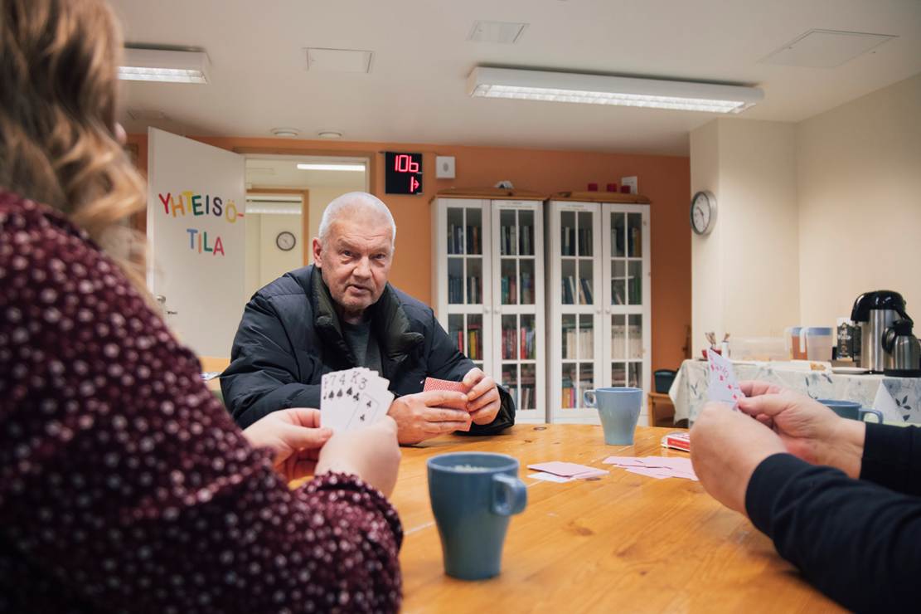
Method: Drop – in center
Drop-in centers or day time activity centers are meant for the people with severe drug or alcohol problems. Customers’ right to always be welcomed, regardless of their sobriety. These places allow you to get help with basic needs, and also give you the chance to meet a social worker. What is more, you have the right to visit anonymously.
These places should be focused on reducing harm, to defend human rights, to help in preventing homelesness and death caused by overdose, as well as to fight for the right for decent human life and health care.

Slide 17
For session III
Which social problems, social phenomenons or structural problems you think community social work can have the most impact in Latvia?
Write it down on the whiteboards

Slide 18
For the session III
Now we vote. Everyone has 5 votes.
We will have a top 5 and we will focus on these tomorrow, in session 3.

Slide 19
Project “Development of professional and modern social work”
E-mail: socdarbs2028@lm.gov.lv
Phone: 67021517

