Slide 1
The FREEDOM TOUR
7 COUNTRIES in 30 MINUTES
YOTAM TOLUB

Slide 3
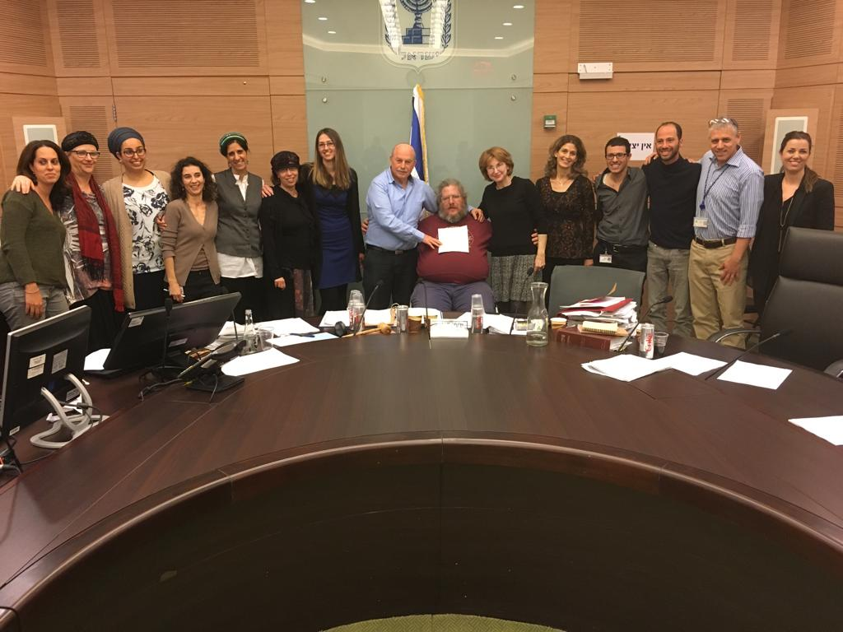
ISRAEL
Legislation process
Detailed legislation
Implementation
Guardianship still default
Fair procedure

Slide 4
1962
Guardianship law
2006
Memorandum
2009
Bizchut new project
Cases, research, awareness raising, international discussion
2012
2016
2017-2021
Ratification of CRPD
2014
Court decision
Pilot
Coalition
2015
Parliament Discussions
New Law
SDM training
Regulations
NGO Training
Court decisions
Academic training
Banks
Government service

Slide 5
I N F O

Slide 6
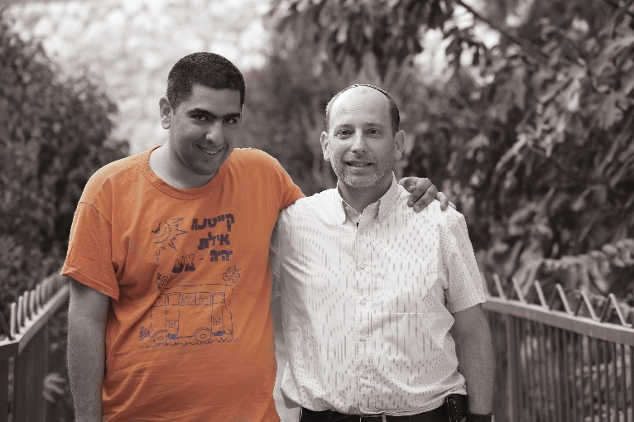
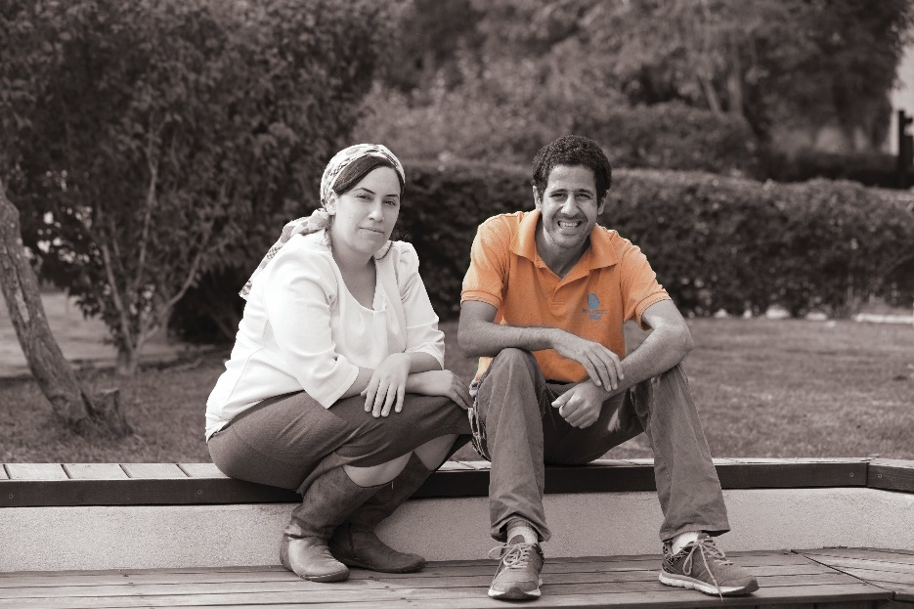
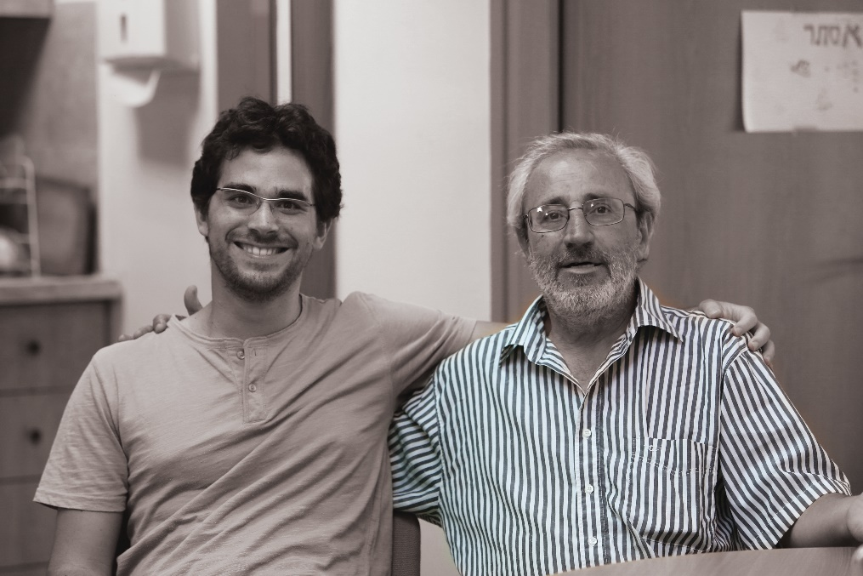
Pilot

Slide 7
Model

Slide 8
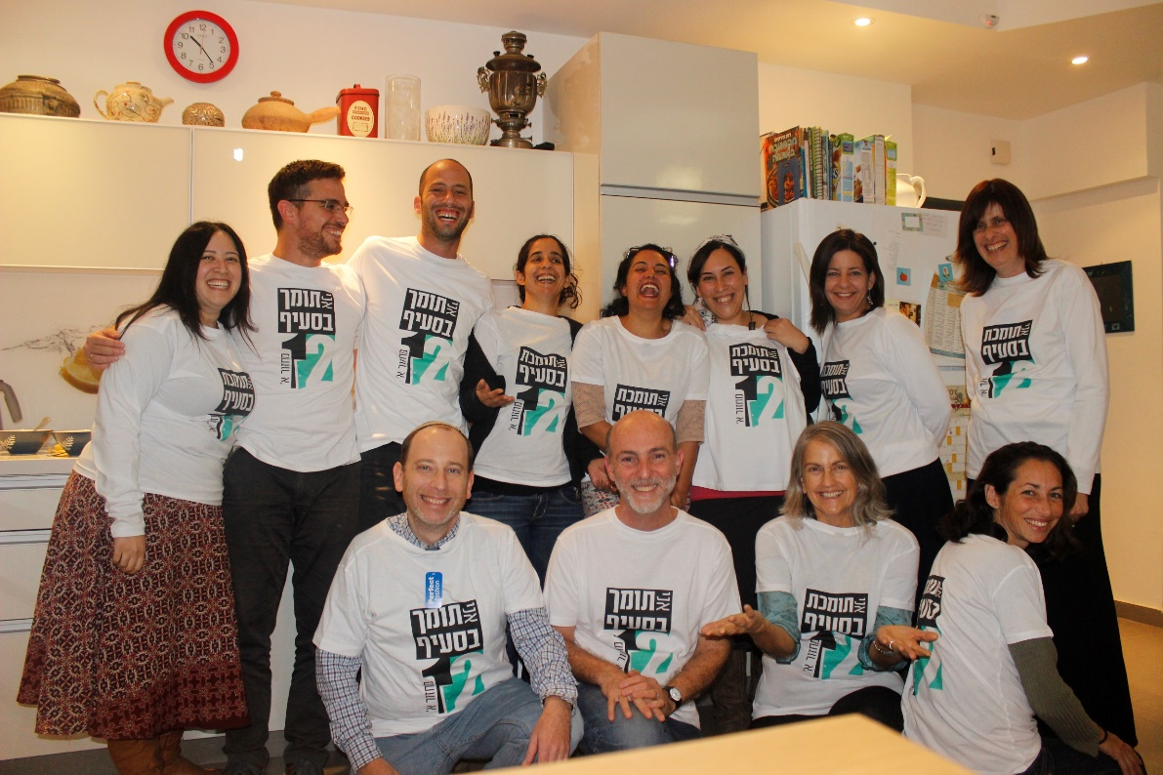
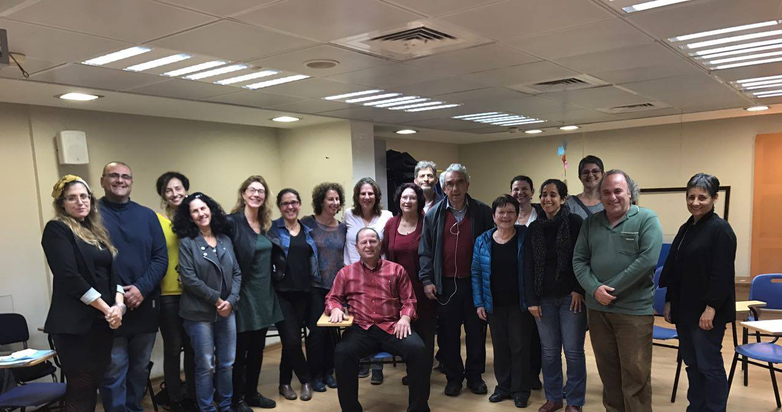
Supporters
Volunteers, Paid/Private, Service
Family members

Slide 9
7 Academic courses
85 Trained Professional Supporters
Court Appointments

Slide 10
IRELAND
Dialogue of government and civil society coalition
No Guardianship
Will & Preferences
Detailed legislation
Implementation

Slide 11
BULGARIA
Detailed proposal
Civil society’s role
Campaigns and Media
Pilot
Legislation failed to pass

Slide 12
BRASIL
Supported decision making is in legislation
Work with department of justice
Parents’ organizations
Implementation
Courts not updated
Guardianship still default

Slide 13
GEORGIA
Legislation
Support of social welfare system
No more incapacitation
Implementation
No support
Lack of information
“capacity”
Medical model

Slide 14
COLOMBIA
Most advanced legislation
Strong civil society involvement
Detailed provisions
Implementation
Opposition

Slide 15
USA
Beginning of Legislation (Texas, Delaware, Wisconsin)
Independent Living
Nothing About us Without Us
CRPD not ratified
Substitute Decision Making still an option

Slide 16
Lessons to be learned:
Legislation is essential but not enough
Cooperation between government and civil society
Nothing about us without us
Implementation is crucial
One chance – use it wisely

