Slide 1
Practical experience in implementing pay transperancy measures
Vita Baliukevičienė, 2022

Slide 2
Situation in Lithuania
Average wage 2021
Pay gap
11,1 %
Male
Male
Employment rate 2021
73,1 %
1661 eur
Female
Female
72 %
1496 eur

Slide 3
Situation in Lithuania

Slide 4
TRANSPERANCY MEASURES
Job advertisements
Remuneration systems
Provision of information to representatives of employees
Publicly announced collective agreements
Publicly announced information

Slide 5
TRANSPERANCY MEASURES: JOB ADVERTISEMENTS
In the job advertisement, the employer must specify information about the size and/or range of the proposed basic (tariff) salary (hourly salary or monthly salary or fixed part of official salary).
State Labour Inspectorate monitors job advertisements and claims that employers comply with these provisions of the Labor Code in the best way.
www.cvonline.lt Product Support Representative DexCom Lithuania, UAB Vilnius € 1700 Galiojimo pabaiga: 2022.09.18 | www.cvonline.lt Derivatives and Collateral Specialist Danske Bank Lithuania Vilnius € 2400 – 3600 Galiojimo pabaiga: 2022.09.23

Slide 6
TRANSPERANCY MEASURES: REMUNERATION SYSTEMS
The remuneration system shall be established in the collective agreement. In the absence of a collective agreement, remuneration systems at workplaces with an average number of employees of 20 or more must be approved by the employer and be made available for all employees to become acquainted with. Before approving or revising the remuneration system, information and consultation procedures must be performed.
The remuneration system specifies the employee categories based on position and qualification as well as the salary range (minimum and maximum) and forms of payment for each of them, the grounds and procedures for allocating additional payment (bonuses and allowances), and the procedure for wage indexation.
Valid collective agreements must be registered and publicly announced.
Ministry of Social Security and Labour registers and publicly anounces collective agreements on the website:
https://socmin.lrv.lt/lt/paslaugos/administracines-paslaugos/kolektyviniu-sutarciu-registras-ir-kolektyviniu-sutarciu-registravimo-tvarka
The Labor Inspectorate publishes recommendations and organizes seminars both on the preparation of a fair wage system and on issues of ensuring equal opportunities at work.

Slide 7
TRANSPERANCY MEASURES
Provision of information to representatives of employees
An employer who has more than 20 employees must, upon the request of the work council or in the absence thereof – the employer-level trade union, provide information that is updated at least once per year depersonalised data on the average remuneration of employees, with the exception of employees holding managerial positions, by occupational group and gender, provided that there are more than two employees in the occupational group;
Publicly announced information
The Board of the State Social Insurance Fund publicly publishes information on the average wages of men and women for each company, if the number of employees in the company is at least 8, and there are more than 3 women and more than 3 men among them.

Slide 8
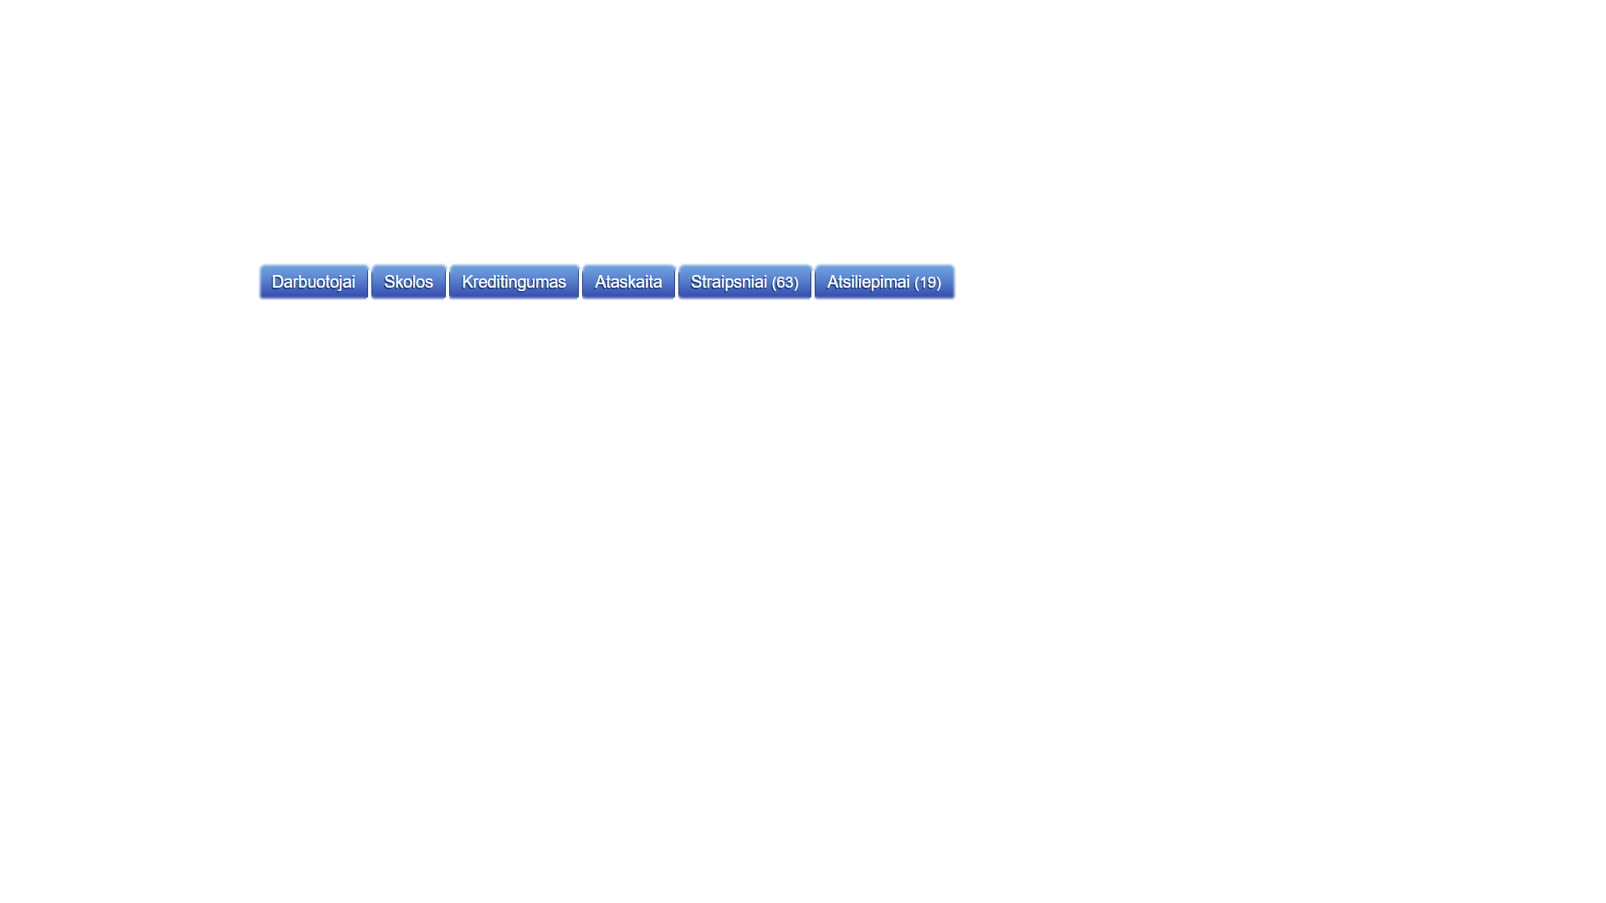
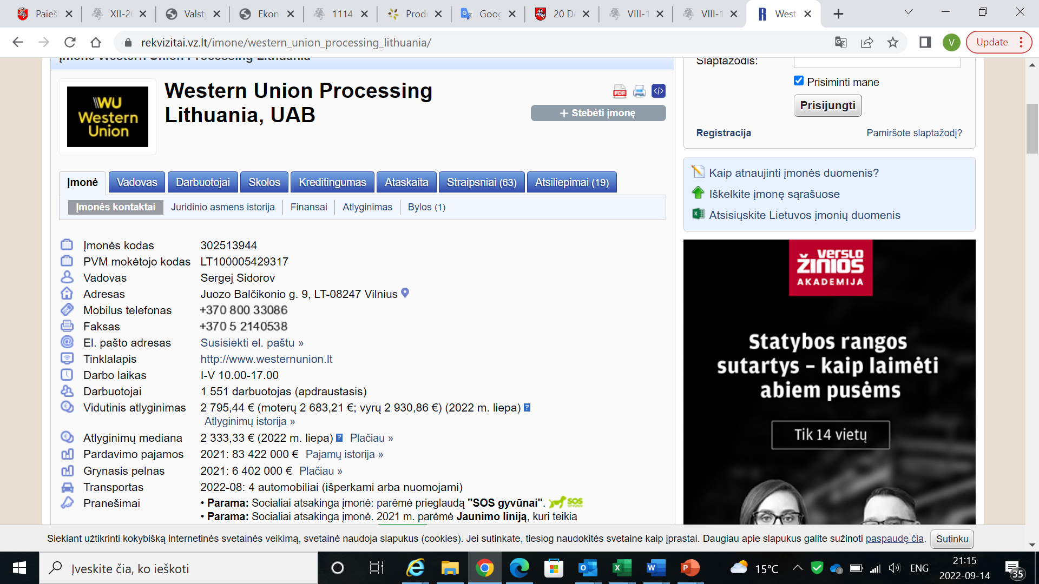

Slide 9
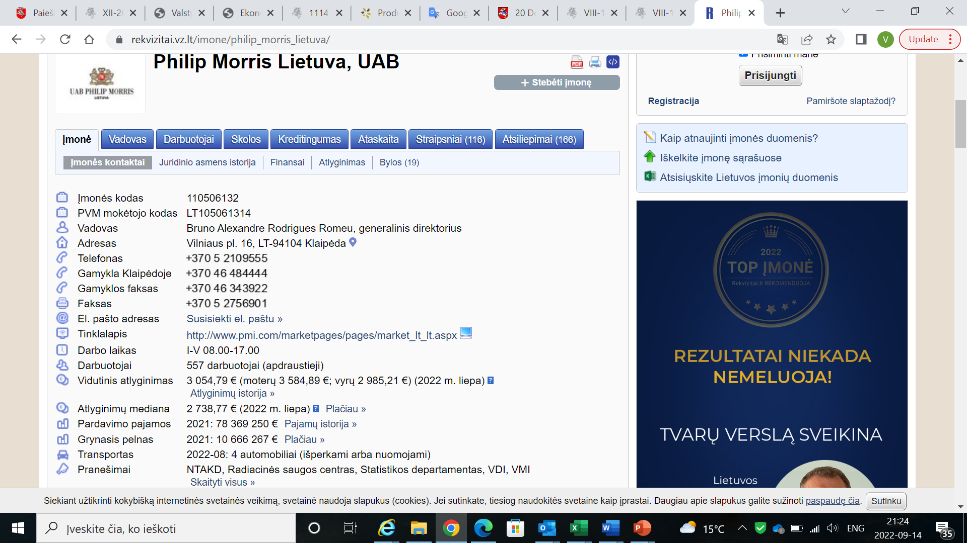

Slide 10
Labour Dispute Commissions
A participant in an employment relationship (also job candidate) who believes that the employer has violated his or her rights as a result of non-fulfilment or improper fulfilment of labour law provisions has the right to apply to a labour dispute commission.

Slide 11
Is there an approved remuneration system in the company?
If the workplace has an approved remuneration system, is it structured in such a way that there is no discrimination on the basis of gender?
Are employees paid equal wages for work of the same or equal value, including all additional earnings paid to the employee in any way by the employer or the employer's representative for the work performed?
Has the employer, whose average number of employees is more than 50, adopted and published in the usual ways in the workplace the measures for the implementation of the equal opportunities policy and the implementation of the principles of enforcement supervision?
Has the employer taken measures to protect the employee, employee representative, employee who testifies or provides explanations from hostile treatment, negative consequences and other harassment when responding to a complaint or other legal proceeding regarding discrimination?
Has the employer created equal conditions for employees to improve their qualifications, seek professional development, retrain, gain practical work experience, and does it also provide equal benefits?
If the criteria for the selection/recruitment of employees are approved at the workplace, are they designed in such a way that there is no discrimination on the basis of gender?
If the criteria for evaluating the work of employees are approved at the workplace, are they made in such a way that there is no discrimination on the basis of gender?
Does the workplace comply with prohibitions on gender employment segregation (tendency to employ only men or only women)?
Does the employer apply uniform selection criteria and conditions when hiring or transferring to higher positions?
Does the employer help employees balance work and family obligations?
Does the employer consider and provide a reasoned written response to the requests submitted by employees in cases established by legal acts, related to the fulfillment of family obligations?
Enforcement
For the third year in a row, State Labor Inspectorate has been investigating the reasons for the wage gap between men and women using such a questionnaire

Slide 12
INVESTIGATION: CONCLUSIONS
No signs of direct discrimination were found due to the wage gap between men and women.
In the inspected Institutions there is a certain trend of distribution of men and women in separate departments of the Institutions: in the majority of inspected Institutions, women dominate in the customer service sector, which usually has the lowest wages in the Institution, while the number of male employees usually significantly exceeds the number of women in IT departments or management boards, which have some of the highest wages in the Institutions.
Wage differences are created in favour of both sexes and are created for objective reasons, such as the employee's qualifications, education, professional experience, professional qualities and behavior, quantity and quality of work, tasks and work tools, the performance of the institution and the contribution of employees to achieve these results.
A large gap between the minimum and maximum wages approved in certain remuneration systems for the same employee category or position may create grounds for discrimination based on gender and/or other grounds, since the decision on wage determination is made by the manager, which may represent a subjective assessment of a specific employee.
There were no employee representatives (work council) in one institution. Given that employee representatives (work councils or trade unions) represent the interests of employees and help and in some sense control the employer's actions or inactions in labour relations, the absence of employee representatives or their only formal involvement can contribute to the wage gap between men and women.

Slide 13
Examples of good practice
Equality matrix
Wage audits
Monitoring
Anonymous Surveys
Salary review takes into account which gender is dominant in terms of salary at a given job level. In this case, employees of the opposite sex are additionally given an increase in wages to reduce the wage gap between employees of the opposite sex (after considering all the necessary conditions).
Wage gap analysis is regularly carried out in Institutions, involving employee representatives in order to quickly assess the wage gap between men and women.
how many men and how many women took advantage of vertical career opportunities, participated in trainings, went on business trips.
The aim is to find out what is the opinion of the employees themselves, both on the wage gap between men and women, and on other issues of discrimination in the workplace.

Slide 14
National Responsible Business Awards
Organized by the Ministry of Social Security and Labor every year.
One of the nominations - Workplace of the Year.
In the form filled out by employers, they must indicate
Does the company apply a policy of equal opportunities (equality) for women and men, a policy for the prevention of gender-based harassment and psychological harassment, the prevention of violence and the prevention of sexual harassment?
Does your company pay equal wages to men and women for the same work of equal value? How do you achieve this and how do you ensure it? Do you monitor equal pay in your company?

Slide 15
?
QUESTIONS

