Slide 1
Why and How do Men Benefit from Gender Equality? White Ribbon Ireland
Presenter – Daniela Monza

Slide 2
Who are the Men’s Development Network?
An organisation which advocates for transforming masculinities
with the intention of creating a gender equal society,
through a community development model which creates better lives for men and boys, their families, friends, and communities across Ireland.
Notes:
Transforming masculinities means changing the norms of what it is to be a man/boy in this world so that people can be their most authentic selves

Slide 3
What is Transforming Masculinities?
Transforming masculinities is a process of engagement for men and boys to explore how their notion or view of masculinity might be beneficial or harmful for them.
It means creating space for other possibilities to emerge, a space for safety, and acceptance.
It means men can empower themselves to reach their full potential.
Transforming masculinities is a pro-feminist approach. For this reason, MDN is a member of the National Women’s Council of Ireland.

Slide 4
Our Vision, Mission and Core Values
OUR VISION
“That men play an active part in all aspects of their lives
and be their most authentic selves”
MISSION
“Better Lives for Men, Better Lives for All”
CORE VALUES
Equality, Non-Judgmental, Professionalism, Partnership & Love

Slide 5
Who are the Men’s Development Network?
White Ribbon
Men’s Health Programme
Leadership Programme
On Feirm Ground 2
MAL Advice Line
MEND Programme
Counselling service
We work to prevent DSGBV, with victims and with perpetrators
Getting Fit for Equality
Notes:
Transforming masculinities means changing the norms of what it is to be a man/boy in this world so that people can be their most authentic selves

Slide 6
The Irish Context

Slide 7
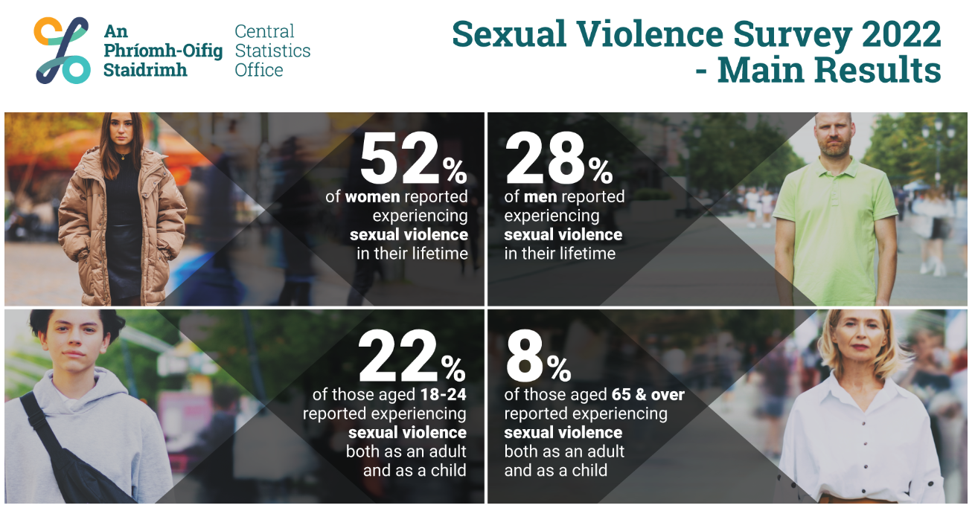
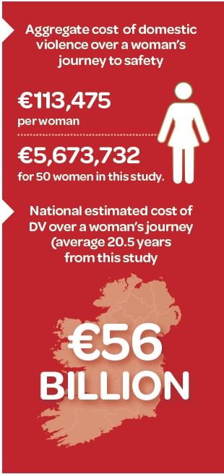
DSGBV in Ireland
Report by Dr Caroline Forde and Dr Nata Duvvury,
Centre for Global Women’s Studies, NUI Galway with support from Safe Ireland.
An estimated cost of 2.7 Billion Euros each year (not including the costs of service provision)

Slide 8
The Irish Response
The Council of Europe Convention on Preventing and Combating Violence Against Women and Domestic Violence (Istanbul Convention – CETS210) recognises domestic, sexual and gender-based violence as a form of discrimination and human right violation. Ireland ratified the convention in 2019.
The Government of Ireland’s ‘Zero Tolerance. Third National Strategy on Domestic, Sexual and Gender-Based Violence 2022 – 2026’.

Slide 9
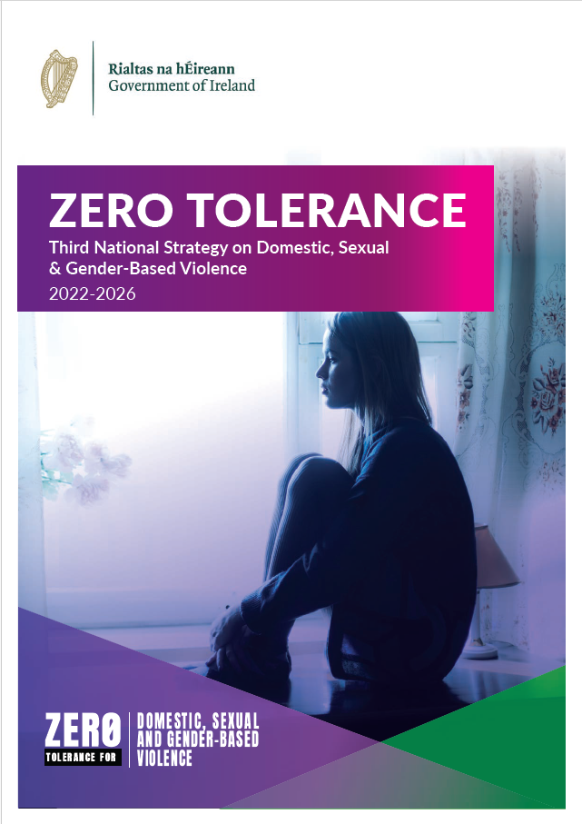
National Strategy
Modeled on the Istanbul Convention
Pillar 1 – Prevention
Pillar 2 – Protection
Pillar 3 – Prosecution
Pillar 4 – Policy Coordination

Slide 10
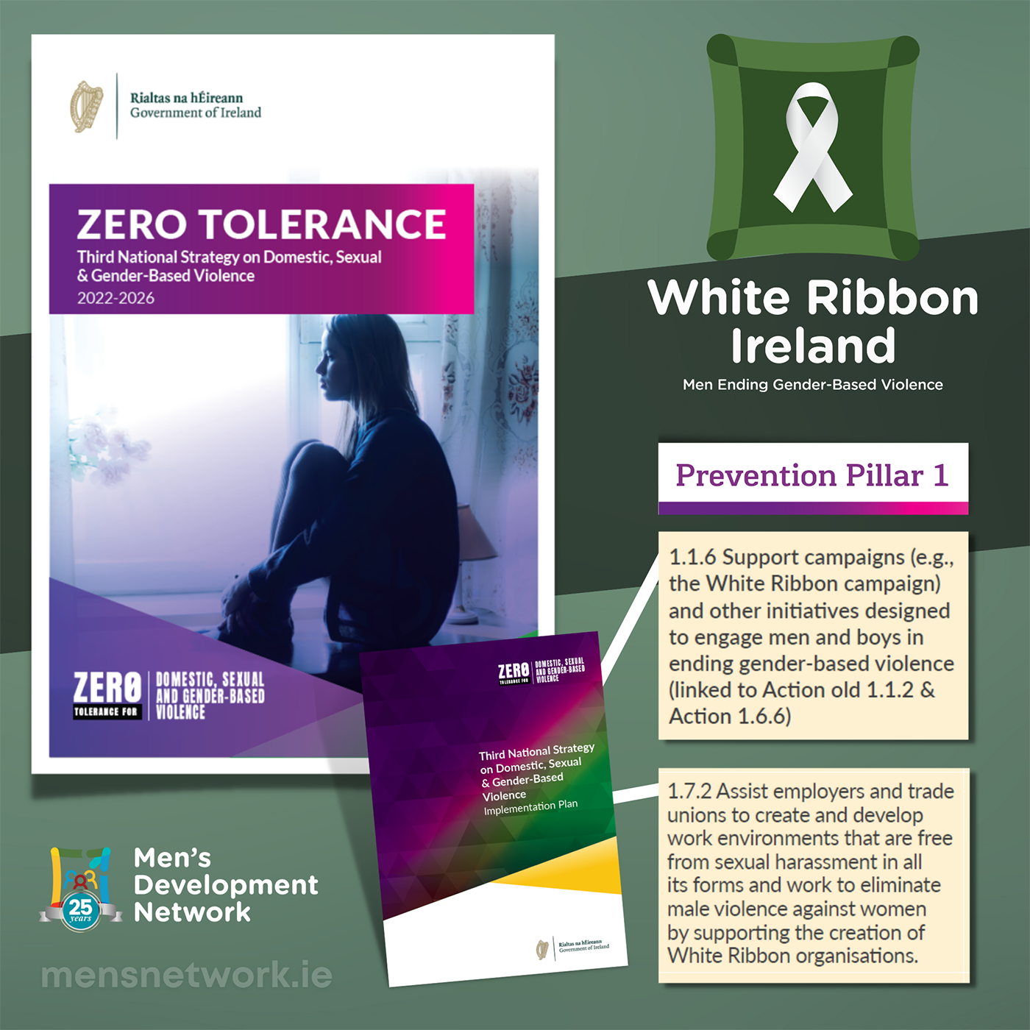
CUAN
2024 – Institution of CUAN
The statutory Domestic, Sexual & Gender-Based Violence Agency coordinating the implementation of the strategy.
A whole of government approach
In partnership with national NGOs delivering frontline services in the area of DSGBV and other community partners.
A whole of society approach to prevention

Slide 11
Equality Legislation
The Equal Status Acts 2000 – 2018 and the Employment Equality Acts 1998 - 2015
The laws prohibit discrimination based on the nine grounds of
Gender
Marital status
Family status
Age
Disability
Sexual orientation
Race
Religion
Membership of the Traveller community
In Workplaces
When accessing goods, services, facilities & accommodation
Notes:
Transforming masculinities means changing the norms of what it is to be a man/boy in this world so that people can be their most authentic selves

Slide 12
White Ribbon is a global movement
Started in Canada in 1991 - in over 60 countries worldwide today
Male led movement
Engage with men and boys on ending Violence against Women and all forms of Gender-Based Violence
Attitudes and behaviours change – raising awareness
The White Ribbon Campaign in Ireland is led by Men’s Development Network.

Slide 13
What leadership means to us?
Leadership is a set of behaviors used to help people align their collective direction, to execute strategic plans […].
[…] leadership is about […] enabling groups of people to work together to accomplish what they couldn’t do working individually. In this sense, leadership is something you do, not something you are.
(McKinsey Explainers, August 2022)
Notes:
James O. McKinsey, a University of Chicago professor and expert on management accounting – McKinsey & Company consulting firm

Slide 14
Who are those men (and boys) we are talking about?
Every man right here, right now!
and every other man and boy in every community, too!
White Ribbon is an invitation, an encouragement, for men to be active in DSGBV prevention and response.
White Ribbon’s role is creating opportunities for engagement and supporting and facilitating the process

Slide 15
White Ribbon Capacity Building Programmes
White Ribbon Ireland is a DSGBV Awareness Campaign with a main focus on 25th November - White Ribbon Day
an Organisations accreditation process, the White Ribbon Organisations Programme (WROP).
a Post-Primary School Programme
Teacher Training

Slide 16
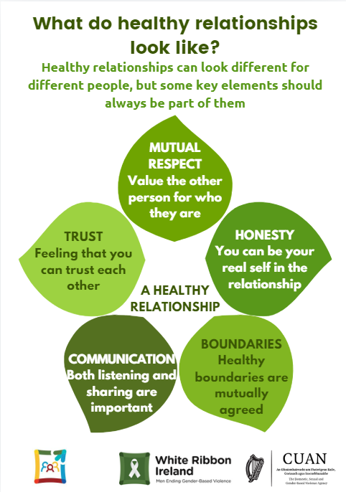
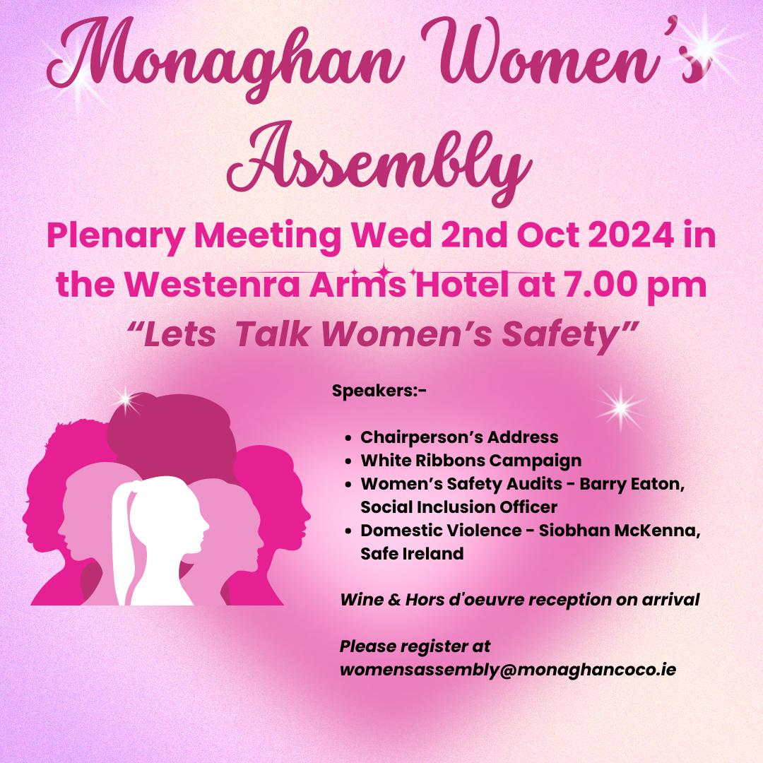
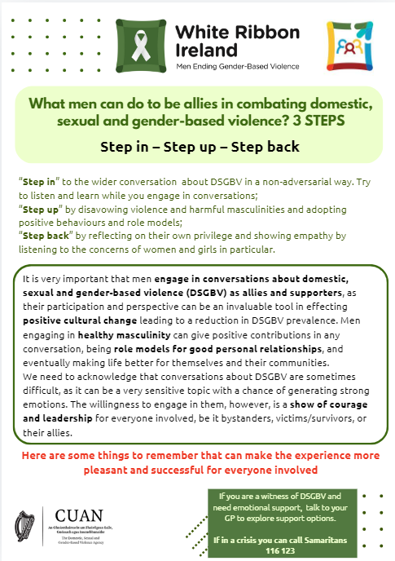
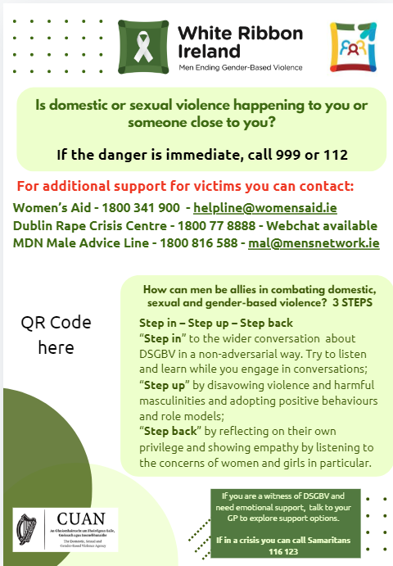
Information & Awareness
White Ribbon Day /
16 Days of Activism
Information & signposting materials
Talks at events

Slide 17
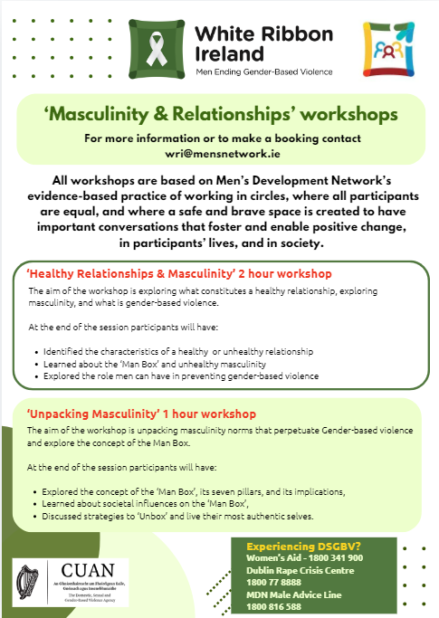
Education Opportunities
Workshops
Topics:
Healthy Masculinity (The Man Box)
Healthy Relationships & Masculinity
Delivered in communities, workplaces, third level education settings, events, etc.
To audiences of all genders

Slide 18
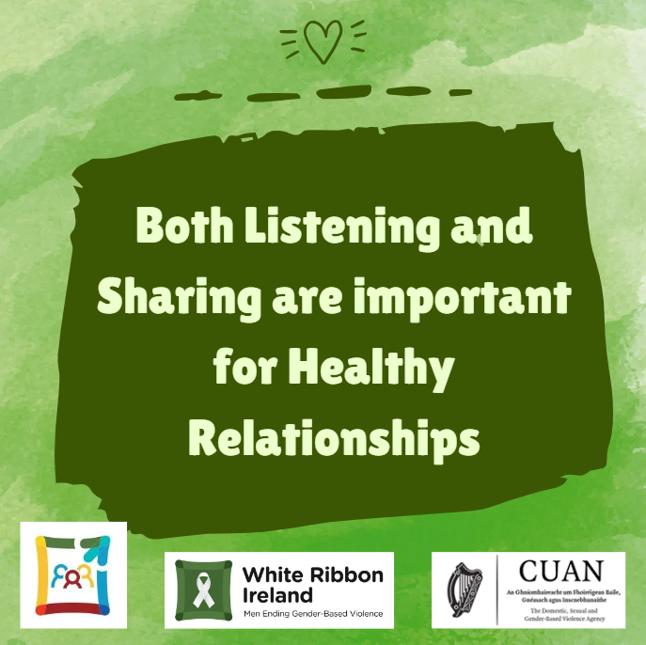
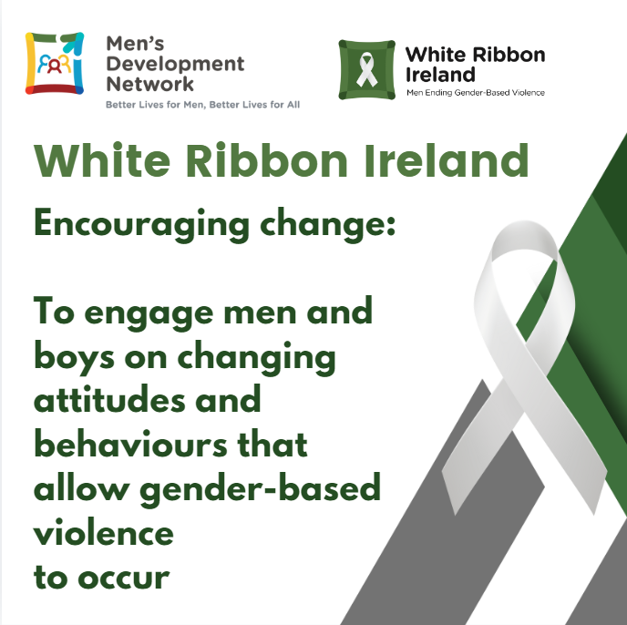
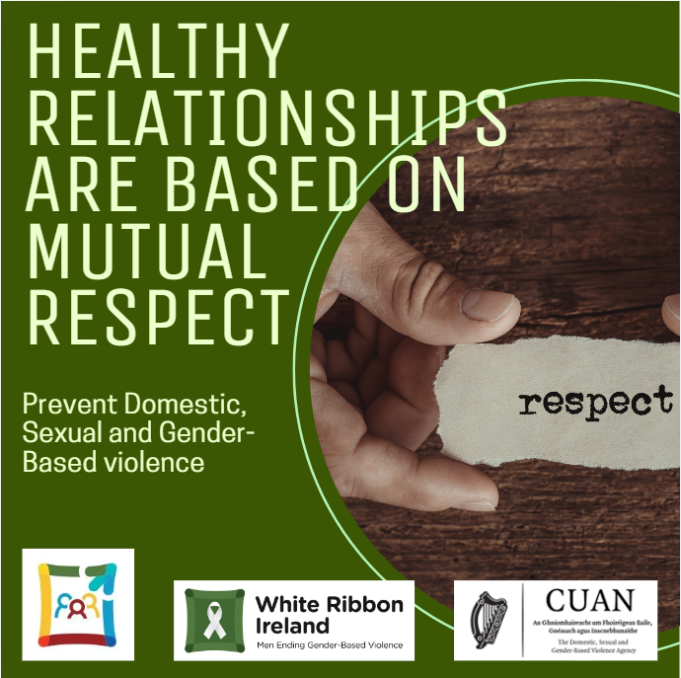
Creating Spaces for Conversations
On Social Media
Engaging with Partners with similar goals
Other NGOs
Public administrations
Employers Organisations and Trade Unions
Sports Organisations
The Media
Etc.

Slide 19
Building Skills & Capacity
Both initiatives are directly in response to the National Strategy as established in its implementation plan.

Slide 20
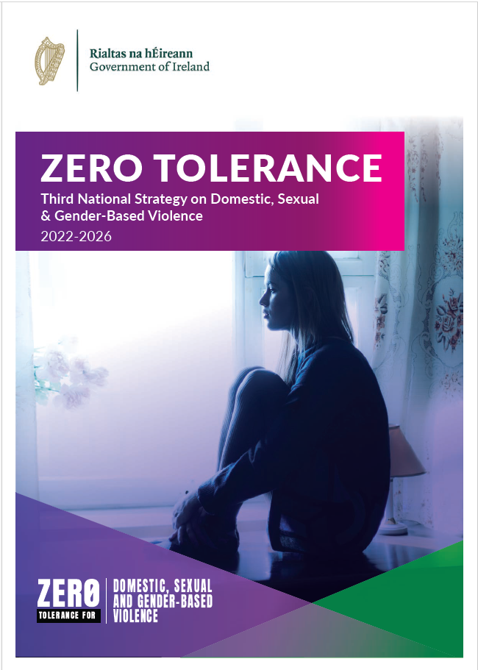
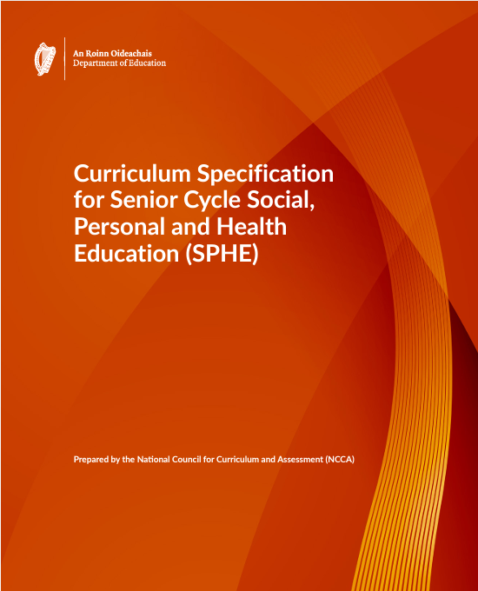
Advocacy
Policy submissions & Recommendations

Slide 21
Our Framework & Methodology

Slide 22
Working in Circles
A significant aspect of Men’s Development Groups is that they are a place for men to be their most authentic selves, which serves as a space to observe and reflect on messages that have influenced, informed, or impacted on our ability to care for our health, wellbeing, and access to services.
Through normalising conversations, we explore the qualities, values and actions that inform positive masculinities.
(MDN – ‘New Conversation with Leaders’ Facilitation Manual)

Slide 23
What does masculinity have to do with DSGBV?
The Man Box
Patriarchal model
Rigid gender norms
Unrealistic expectations of compliance
Expectation of Social Dominance
Violence towards women and minorities
Rigid gender norms, including hegemonic (Harmful) masculinity is one of the root causes of Domestic, Sexual and Gender-Based Violence
Poor(er) health & life outcomes for men
Notes:
Hegemonic masculinity is a concept developed by Australian sociologist Raewyn Connell.
The patriarchal model of society determines very rigid gender norms for what it means to be men or women and creates unrealistic expectations of compliance for individuals. Those unrealistic expectations are inherently unhealthy, for both genders, and for everyone else who is not adhering to these rigid norms for any reason. The trade-off for men if they adhere to these strict gender norms is social dominance. However, this comes with a price. DSGBV is a mechanism certain men use to maintain their social dominance (real or perceived).

Slide 24
The MAN survey of 2022
According to MDN’s MAN survey 2022, the Irish men who participated, hold quite progressive personal views about masculinity and gender equality. E.g.
the mean figure for combined disagree and strongly disagree to Homophobia across all age groups was 93.6%
60+% of men strongly disagree that men should have the final say about decisions in their relationships or marriage
However, the majority of participants thought that society in general had far less progressive views than they had themselves. These views constitute the cultural expectations of masculinity, which can create peer pressure on individual men.
Notes:
Hegemonic masculinity is a concept developed by Australian sociologist Raewyn Connell.
The patriarchal model of society determines very rigid gender norms for what it means to be men or women and creates unrealistic expectations of compliance for individuals. Those unrealistic expectations are inherently unhealthy, for both genders, and for everyone else who is not adhering to these rigid norms for any reason. The trade-off for men if they adhere to these strict gender norms is social dominance. However, this comes with a price. DSGBV is a mechanism certain men use to maintain their social dominance (real or perceived).

Slide 25
Benefits of working with men in violence prevention
Violence reduction
Men towards women
Men towards themselves
Men towards other men
Jackson Katz, PhD
Notes:
Hegemonic masculinity is a concept developed by Australian sociologist Raewyn Connell.
The patriarchal model of society determines very rigid gender norms for what it means to be men or women and creates unrealistic expectations of compliance for individuals. Those unrealistic expectations are inherently unhealthy, for both genders, and for everyone else who is not adhering to these rigid norms for any reason. The trade-off for men if they adhere to these strict gender norms is social dominance. However, this comes with a price. DSGBV is a mechanism certain men use to maintain their social dominance (real or perceived).

Slide 26
Why and How do Men Benefit from Gender Equality?

Slide 27
The Man Box
Men and boys are socialized in a way that requires adhering to strict gender norms which establish what is expected from and acceptable for men and boys.
This is a taught behaviour, achieved through messaging coming from family, education settings, faith leaders, peer culture, the media, the world of sport, media influencers, the gaming culture, etc.
These norms are also continually reinforced in society
Individual level – peer pressure, discrimination, exclusion, and in extreme cases, violence
Systemic level – legislation, policy, etc. (e.g. paternity leave, access to housing, etc.)

Slide 28
7 Pillars of the Man Box
Self-sufficiency
Acting Tough
Physical Attractiveness
Rigid Masculine Gender Roles
Heterosexuality & Homophobia
Hypersexuality
Aggression & Control

Slide 29
Expected Benefits of the Man Box
Privilege
Freedom from domestic (unpaid) work
Safety form violence
Economic power
Political power
Gender pay gap
Gender bias in healthcare
Access to leadership roles
Family status does not affect career prospects

Slide 30
The Man Box side effects
Self-Sufficiency – deters men from asking for support or seek healthcare. It can negatively impact their physical and mental health outcomes
Acting Tough – It can encourage risky behaviours to ‘prove their masculinity’ – they can lead to injury or death
Physical Attractiveness – The constant pursuit of physical prowess and fitness – it can lead to stress, injury, and discrimination towards men who are disabled or less fit
Rigid Masculine Gender Roles - Reduced range of options and possibilities in life (e.g. hobbies/interests, careers, personal look, etc.)
Heterosexuality & Homophobia – Discrimination towards men who are considered ‘less masculine’, hate and, eventually, violence
Hypersexuality – Difficulty in maintaining romantic relationships, risky sexual behaviours
Aggression & Control – Violence is acceptable

Slide 31
Equality
If gender makes no difference,
why put all that effort in complying?

Slide 32
The Effect of Gender Equality
Gender equality minimises the side-effects of adopting rigid gender norms and unhealthy perspectives of masculinity. It encourages healthier behaviours and attitudes.
By advocating against gendered structures of inequality, men and boys are liberated from the costs of conformity with hegemonic definitions of masculinity.

Slide 33
Individual Level Benfits
Support-seeking behaviours
Better Health Outcomes
Embracing their ‘soft’ side
Better emotional awareness & management
Less focus on appearance or fitness
Reduced risk of injury or burnout
Flexible gender norms
Access to a variety of careers or activities
Acceptance of own sexual orientation or gender identity
Better sexual health
Reduced levels of violence
Reduced risk of injury
Reduced stress & trauma
Reduced risk of poor mental health & suicide
Reduced stress
Notes:
It’s done in three stages. Every organization can move at their own pace, ideally it should take between 6 months to one year to complete each stage.

Slide 34
Better relationships
Men and boys live in a social relationship with women, girls and people of other genders, including other men and boys.
The quality of every man's life depends to a large extent on the quality of those relationships.

Slide 35
Relational Level Benefits
Support-seeking behaviours
Expanded support network
Embracing their ‘soft’ side
Easier to relate with other people
Less focus on appearance or fitness
Acceptance of disability, ageing and diversity
Flexible gender norms
Ability to view other people’s perspectives
Acceptance of diverse sexual orientations or gender identities
Reduction of sexually aggressive or risky behaviours
Reduced levels of violence
Towards women
Towards other men
Towards themselves
Engaging in teamwork
Caring and parental roles within the family
Mutual support between partners in romantic relationships
Notes:
It’s done in three stages. Every organization can move at their own pace, ideally it should take between 6 months to one year to complete each stage.

Slide 36
Benefits for society
Gender reforms benefit the wellbeing of the communities in which men and boys live.
Healthier and Safer communities are better for everyone.

Slide 37
Societal Level Benefits
Support-seeking behaviours
Demand for specific male health programmes
Embracing their ‘soft’ side
Demand for paternal leave
Less focus on appearance or fitness
Less societal pressure on men and boys to ‘perform’
Flexible gender norms
Equality in workplaces
Acceptance of diverse sexual orientations or gender identities
Reduction of sexually aggressive or risky behaviours
Reduced levels of violence
Safer communities
Men’s perspective in healthcare & social services
Male representation in caring and childhood related careers
Same sex marriage or LGBTQI+ protections legislation
Increased pool of talents
Increased workforce diversity
Safer communities
Notes:
It’s done in three stages. Every organization can move at their own pace, ideally it should take between 6 months to one year to complete each stage.

Slide 38
Benefits for men
Gender equality, and adopting transformative views of masculinity, benefits men personally, in their relationships, and the whole community.

Slide 39
How Can Men & Boys Engage in Gender Equality work?

Slide 40
Simple ways in everyday life
Use Gender Neutral Language to reduce gender stereotyping. E.g. Police Officer instead of Policeman
Role Model Respect. For everyone, including women, girls and all minorities
Respect Other People’s Gender Identity. E.g. Use of pronouns
Confront Unconscious Bias. Bias that disadvantage women and minorities.
Normalise Difficult Conversations. Emotional check ins, calling out sexist behaviour, challenging stereotypes, etc.
Foster Diversity and a Culture of Inclusion.

Slide 41
A more strategic approach
3 Leadership actions
3 STEPS
Step in – Step Up - Step back

Slide 42
Step in
Step into conversations
With women and girls, to learn about their experiences, in a nonjudgmental way, without assumptions, as a form of allyship.
Mutual understanding is a key element of working together to make communities better and safer.

Slide 43
Step up
Choose positive role models
Disavow unhealthy or negative role models and choose role models who support respect for all, equality, and partnership between genders.
Get involved in initiatives that promote gender equality.

Slide 44
Step back
Take a step back
Take time to reflect on their privilege, on how inequality negatively affects disadvantaged groups.
Educate themselves on how equality is a human right, and how it benefits everyone; how it leads to a better quality of life, and safer communities for everyone.

Slide 45
The systemic Approach – Policy and Legislation
Political action
It is a legal obligation for countries who ratified the Istanbul Convention
Lawmakers have a duty to lead, and ending DSGBV is a leadership matter
Social costs related to DSGBV are immense (cost of healthcare, housing, policing, the prison system, provision of social services, etc.)

Slide 46
Thank you! Any Questions?
Contact details – Daniela Monza – wri@mensnetwork.ie

