Slide 1
How can boys and men transcend masculine stereotypes? Insights from practical interventions.
Equality together: strengthening the role of boys and men in building an equal society
Andreas Beck Kronborg, Head of Secretary
Master of Education Science

Slide 2
Agenda
Briefly about DareGender
Elaborations on challenges within men’s equality; the danish perspective
On the Man Group Concept. Why and how?
The outcomes of DareGender’s Man Groups. Where and how does the transcend happen?

Slide 3
About Daregender
Founded in 2016, the organization was established in response to a perceived gap in Denmark's equality efforts, specifically the lack of a clear focus on including and engaging boys and men in this work
Its mission is to transcend polarizing debates, encapsulated by the slogan: ‘Equality through All Genders’.
While emphasizing engagement with the ‘mainstream man’, the organization remains committed to diversity, as well as the promotion of norm-critical thinking and approaches within its initiatives.

Slide 4
On the challenges
@britishGQ
Maria Baranova

Slide 5
On the challenges – the danish perspective
Privileged
From a focus on challenges within equality faced by women
To a focus on challenges faced by marginalised groups through an intersectionally lence
Marginalised

Slide 6
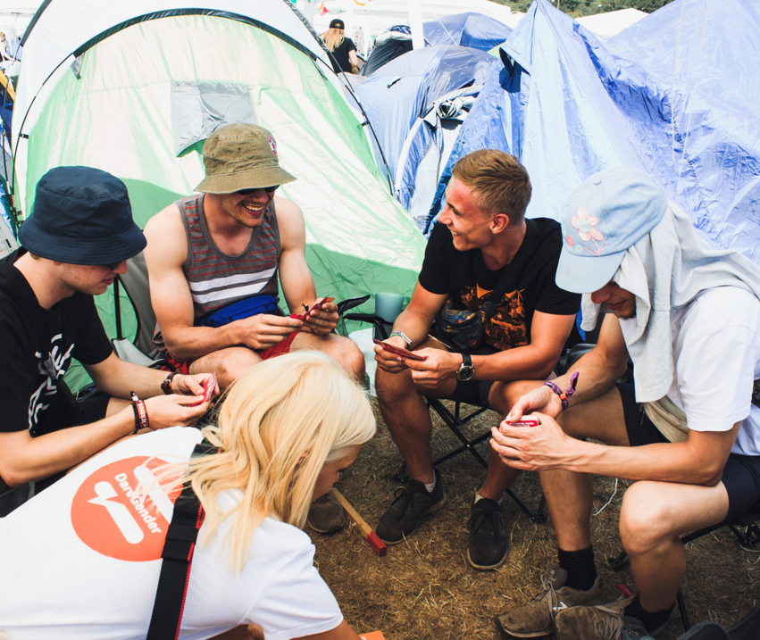
On the challenges – the danish perspective
Privileged
Boys in school and their academic skills
Men in rural areas and their health
Risk behaviour
DareGender

Slide 7
On the challenges – the danish perspective
Every fourth man between the age of 18-34 in Denmark believes equality has moved too far.
70% of women who can wote, believes equality lacks.
Nearly 40% af men, who can wote, agree.
Mandag Morgen, 2023

Slide 8
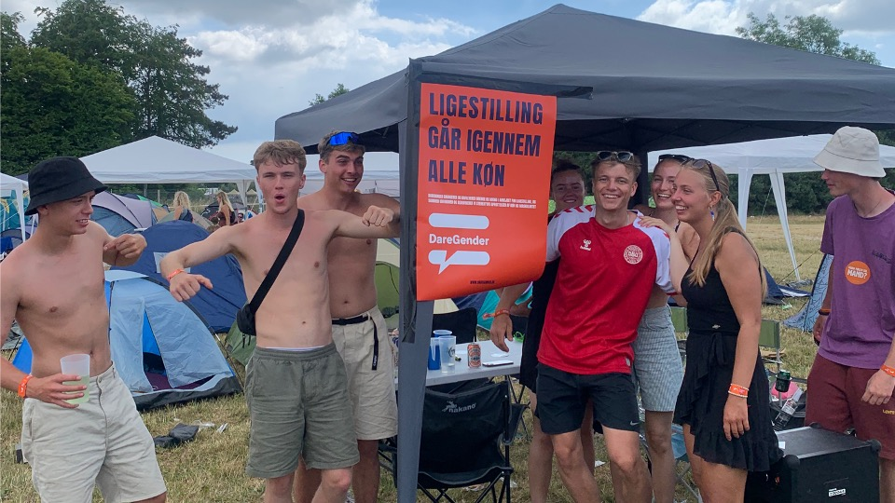
On the challenges – the danish perspective
One out of five men, dont have any or almost dont have any they can share their thoughts to in confidentiality.
Men underreport in questionaires.
Men commits suicide three times more than women.
Forum for mænds sundhed
DareGender

Slide 9
On the challenges – the danish perspective
Privileged
Boys in school and their academic skills
DareGender

Slide 10
On the challenges – the danish perspective
Womens achievements
Zero sum game
Challenges within men’s equality
Provide & protect
Careing gene
A role vs fluidity
Violence
Partriarchy
Male as a gender

Slide 11
Agenda
Briefly about DareGender
Elaborations on challenges within men’s equality; the danish perspective
On the Man Group Concept. Why and how?
The outcomes of DareGender’s Man Groups. Where and how does the transcend happen?

Slide 12
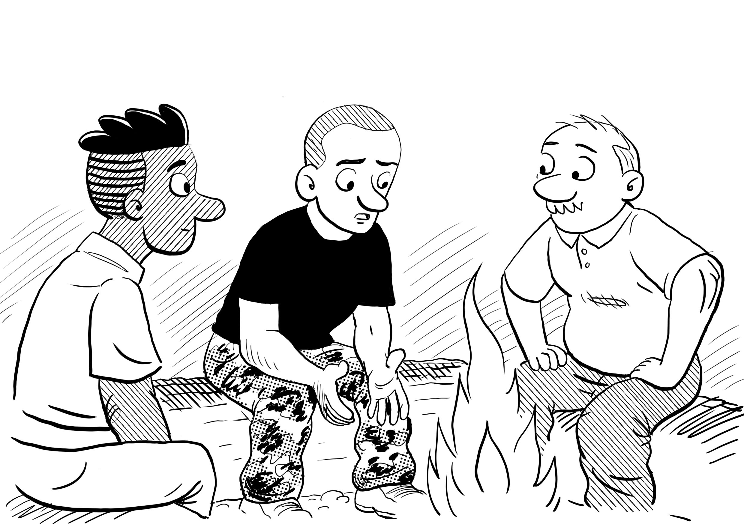
On the man group concept - The WHY
Men need a place to
practice
explore
share
challenge the stereotypes

Slide 13
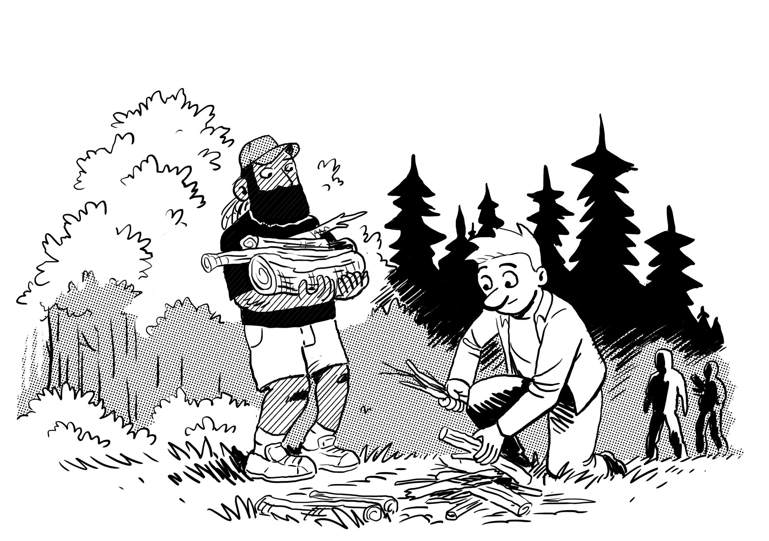
On the man group concept - The how
Safe and surportive environment
Building new ressources and tools
Mirroring and reflection
Improved wellbeing
Supportive network

Slide 14
On the man group concept - The how
Training of volunteers:
Recruitment of volunteers
Facilitatorcamps
Teams of two
Reading the guide
Sparring

Slide 15
On the man group concept - The how
Two approaches:
Gender has no essens
No victimizing

Slide 16
On the man group concept - The how
Five methods:
Listen!
Stay in your lane
No comments or giving advice
No judgement
Theme

Slide 17
On the man group concept - The how
Working gender consciuous:
We don’t add anything.
In stead, we remove traditional behaviours formed by social structures about being a man.

Slide 18
Agenda
Briefly about DareGender
Elaborations on challenges within men’s equality; the danish perspective
On the Man Group Concept. Why and how?
The outcomes of DareGender’s Man Groups. Where and how does the transcend happen?
Notes:
So I have stated some challenges within men’s equality from a danish perspective as of now, and will move forward to give you insights on one of our activities in DareGender were men allow themselves to engage in their mental health and explore how masculine stereotypes affects them.

Slide 19
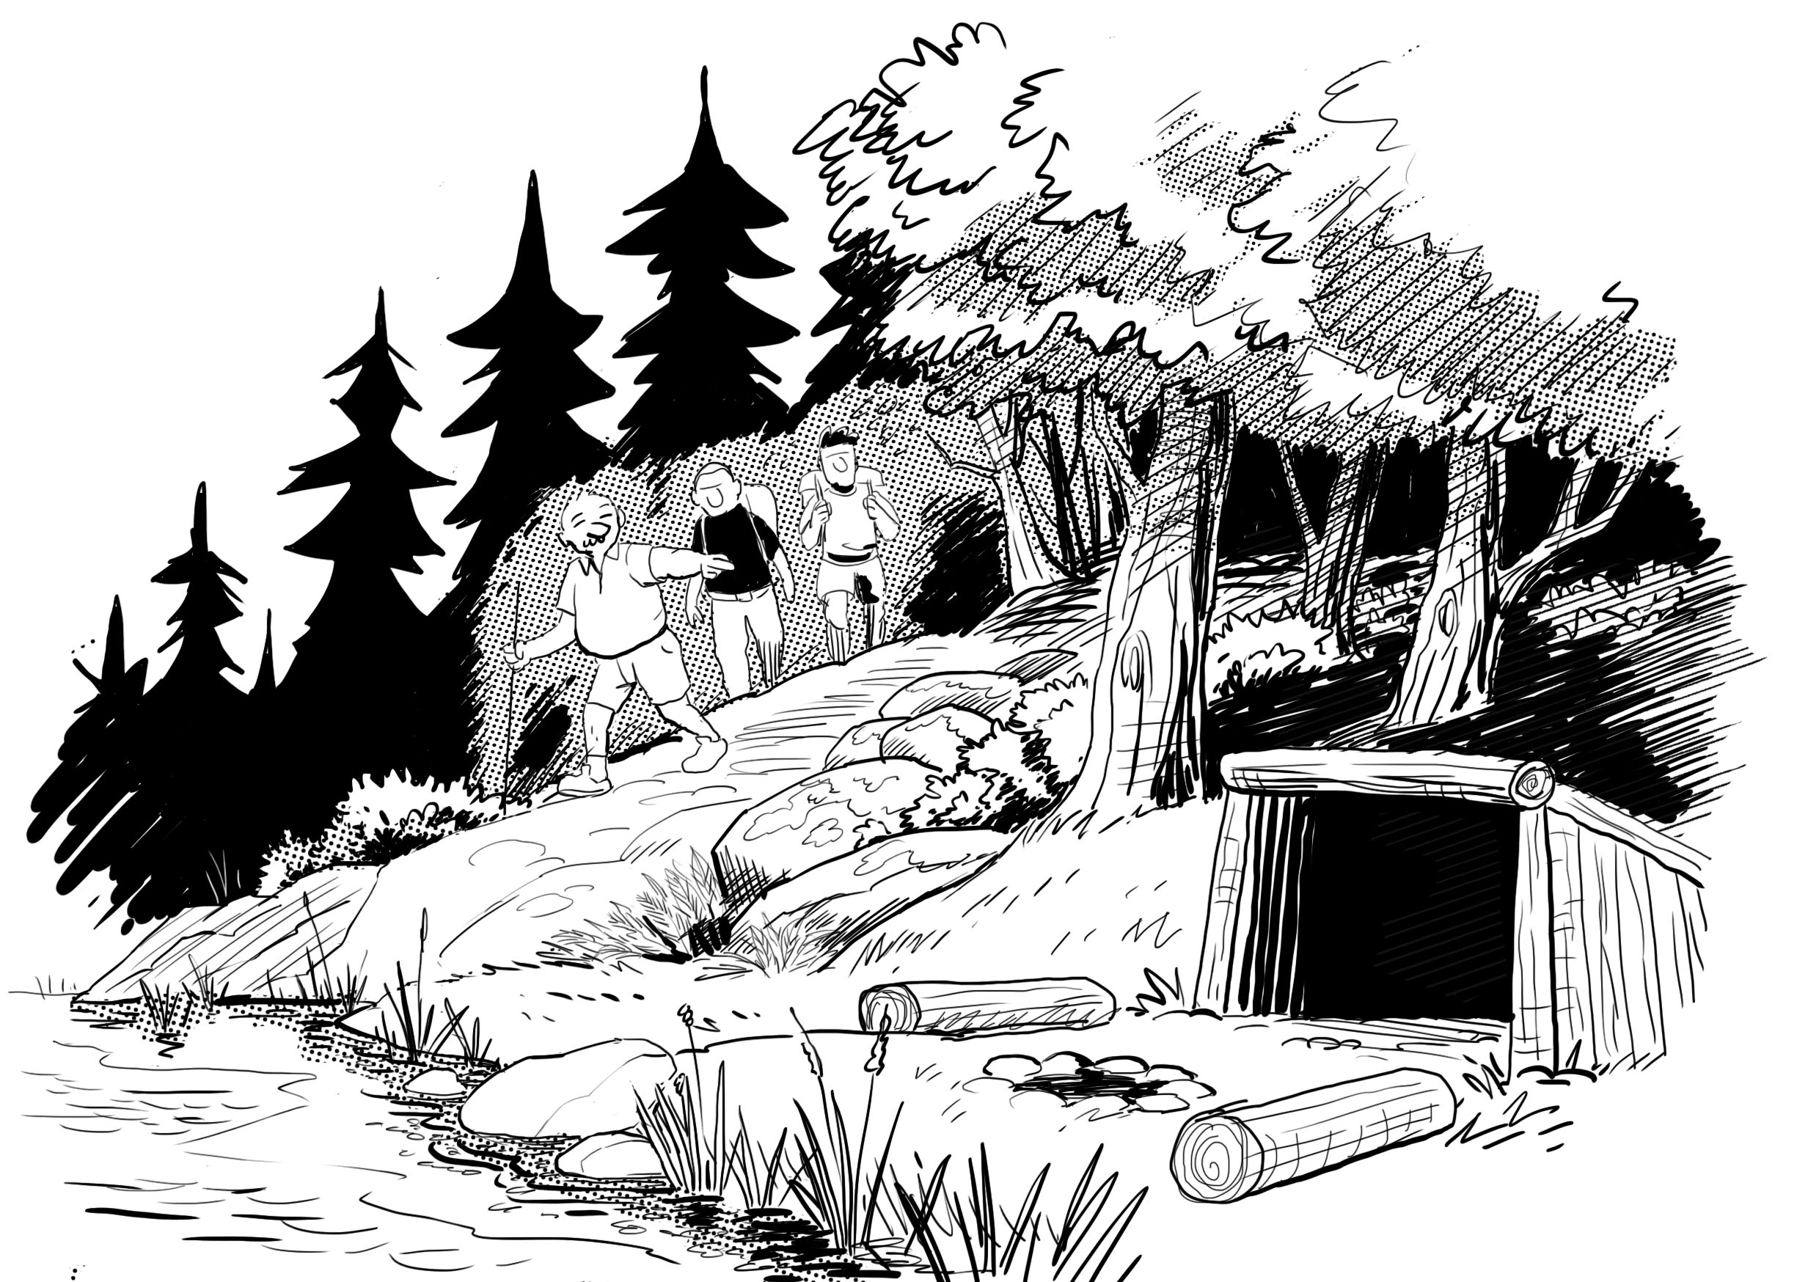
The outcome of Daregender’s man groups
5 central outcomes
Less feeling of loneliness
Outlet for emotions
Feeling of being good enough
Strengthened social skills
Personal development
Increased mental health

Slide 20
The outcome of Daregender’s man groups
It really is uplifting to hear the others share in the group. It shows we are all human. We all face these challenges. Everyone can experience the feeling of shame, we can all feel that we are not good enough. These basic feelings. This really shows, you are not alone.

Slide 21
The outcome of Daregender’s man groups
After participation in a man group:
86% states, they’ve become better at expressing themselves in their relations
91% states, they’ve become better at listening to other peolpe
95% states, they’ve become more aware on their mental health and wellbeing

Slide 22
Where and how does the trancend happen?
In the conversation.
By becoming aware of the oppression of negative social structures and how they affects us
By realising they are not alone.
By being honest in their relations.

Slide 23
Thank you for listening abk@daregender.dk @daregender

