Slide 1
Notes:
Handuppräckning:
Who’s from civil society NGO
Municipality – social services
Schools?
Agancies or govrnement
Politicians

Slide 2
Making accessible support for boys and men.
Notes:
Support services and health care are open for men in Sweden. That is not the problem, the problem is that they dont access it. Today I thought I would talk a bit about how we strive to make support accessible and mitigating thresholds.

Slide 3
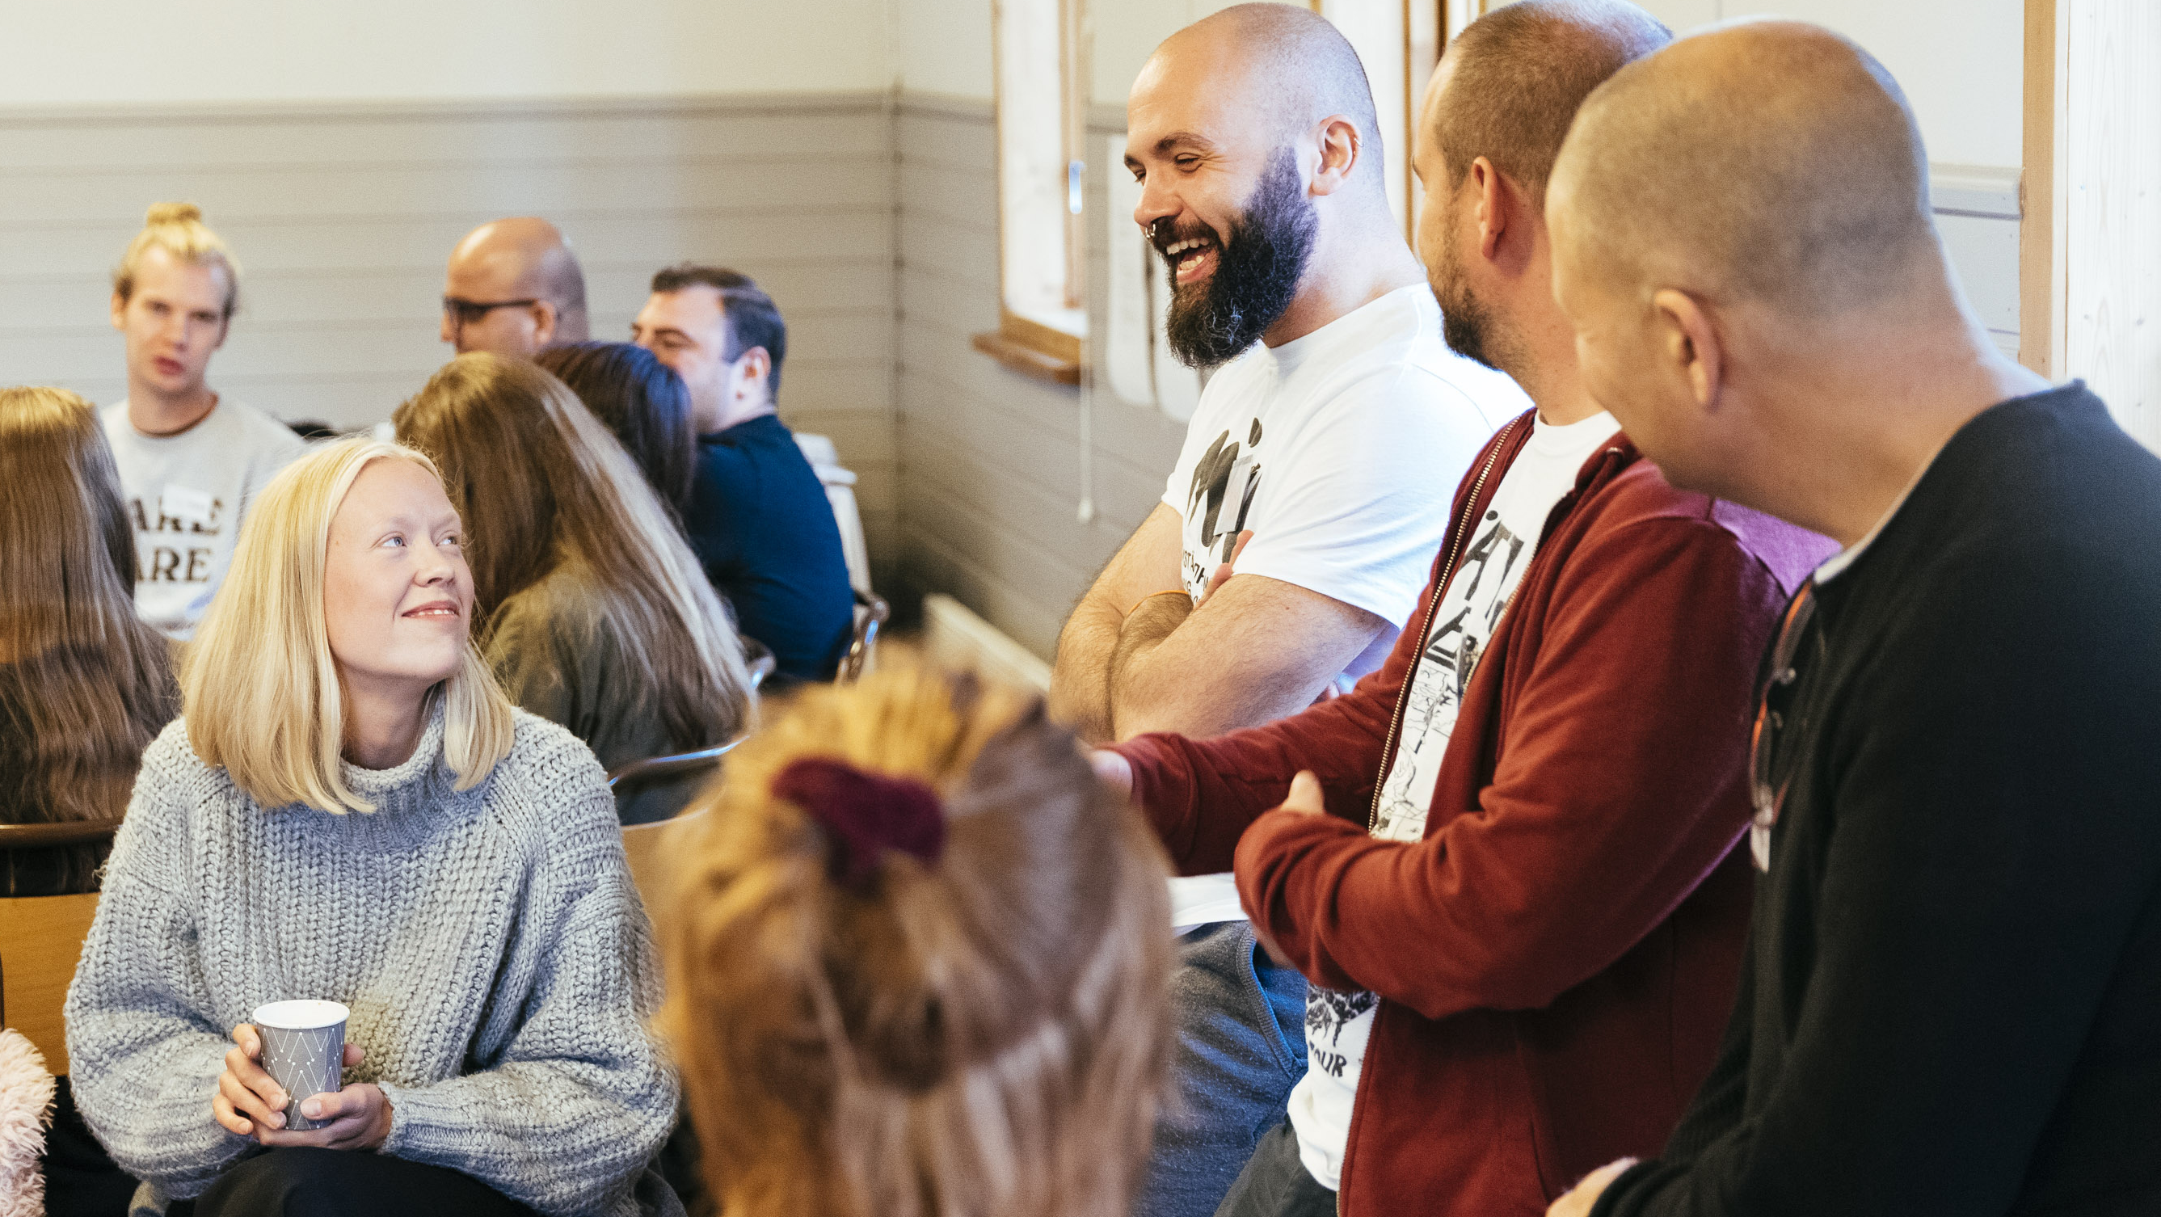
Notes:
First, really short about the organization. Whe are called MÄN, which means men. Because we work with men. We are a members organization with 2500 members in 24 local chapters all over sweden. We have a professional organization that work with four main focus areas….

Slide 4
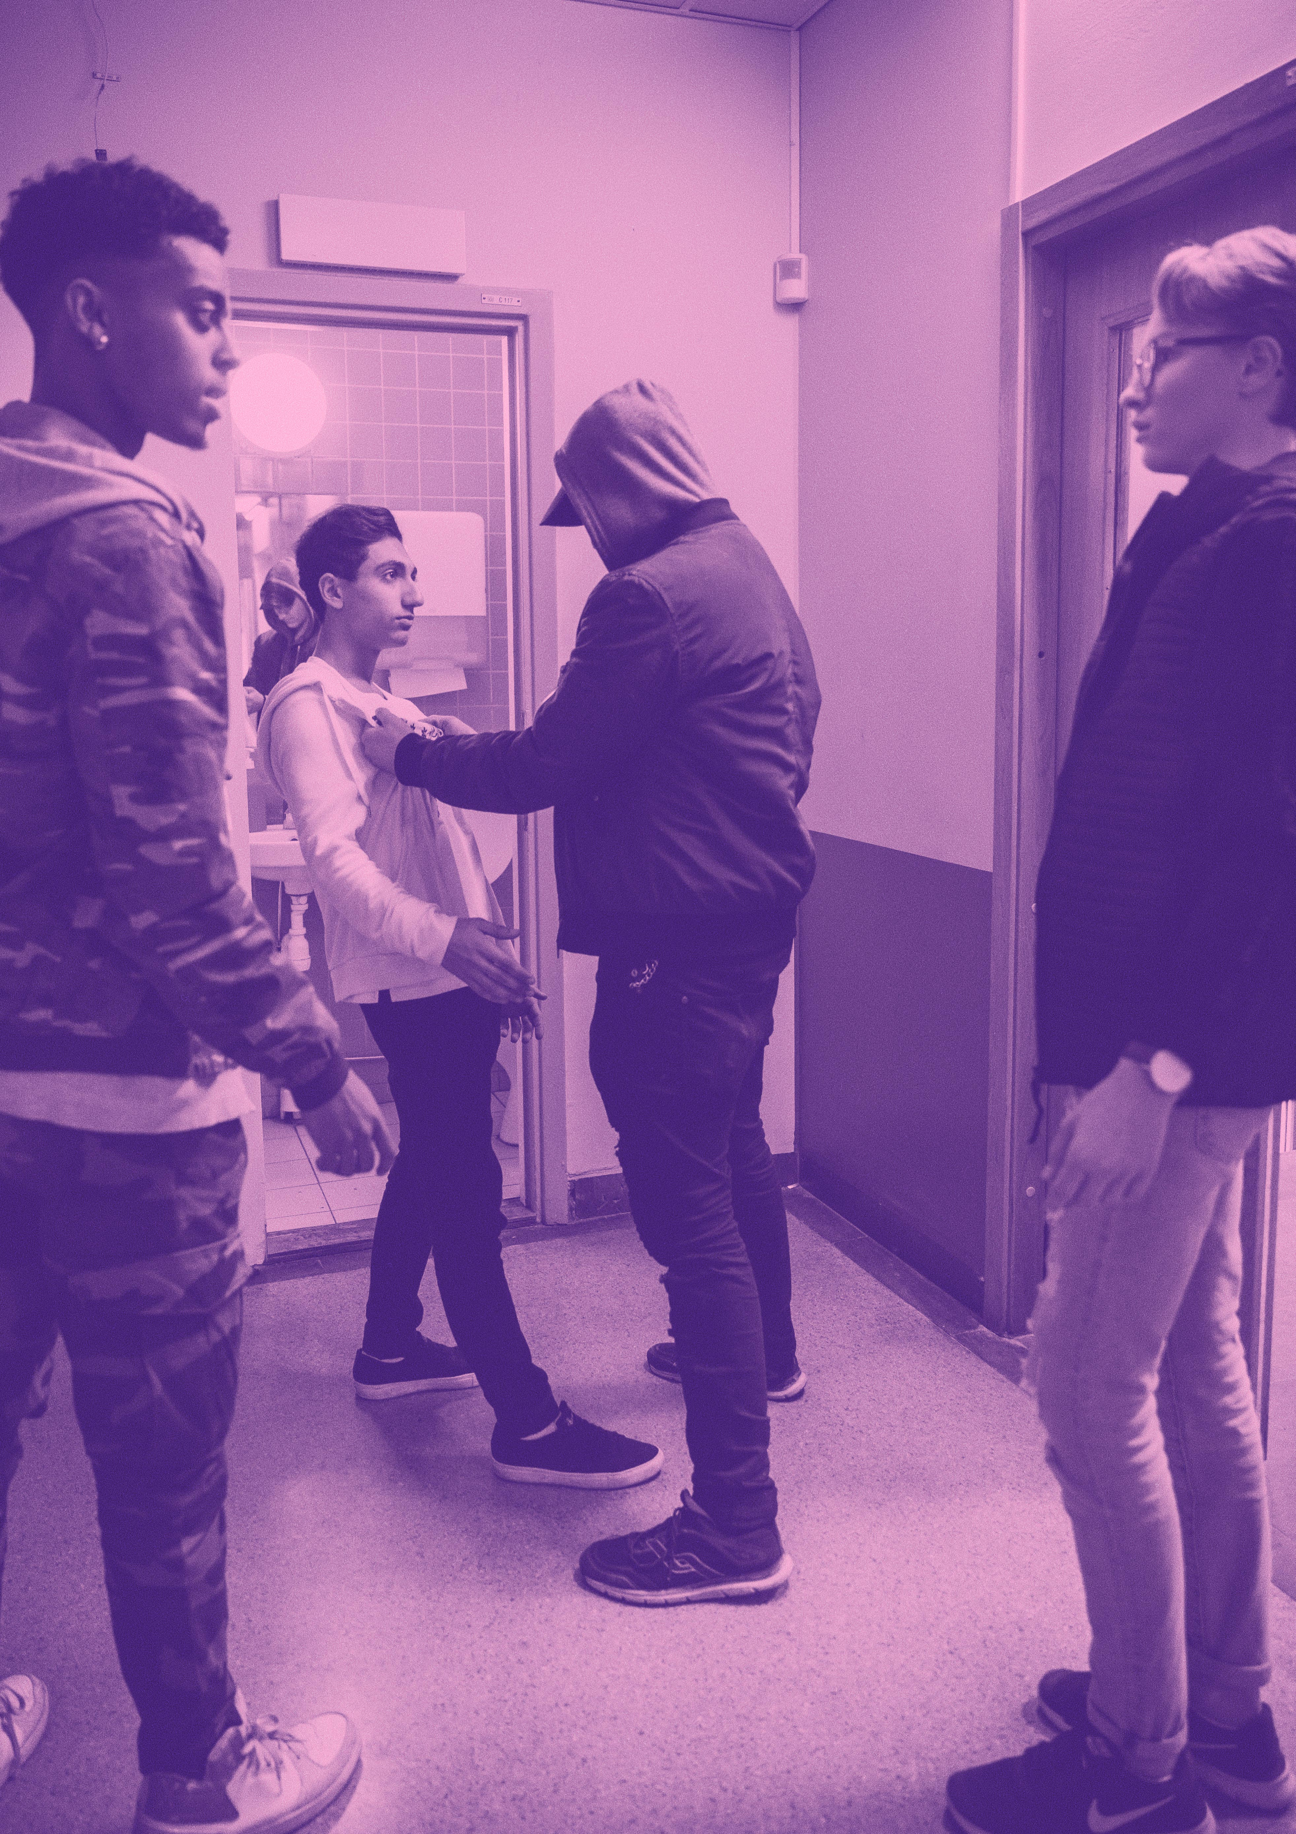
Promote men’s caregiving | Support boys | Challenge norms | Prevent violence
Notes:
Father groups – separated dads new project – divorce can lead to anger, isolation and harm for children
Support boys and young men between 10 and 25. digital plattform, volunteers and a councelling centre
Challange norms – in school and in individual talks we challange the destructive and often narrow norms that young people live by and are affected by.
We work with violence prevention. Bystander approach, early prevention. We train trainers. In schools, work places
WHY do we do this?

Slide 5
Why do we do it?
79% | 98% | 71% | 30% | 11%
Notes:
79 % av de som är misstänkta för misshandel är män (2021)
98 % av de som är misstänkta för sexuella övergrepp är män (2021)
71 % av alla självmord begås av män (2021)
Pappor tar endast ut 30 % av föräldraledigheten
11 % av de som söker stöd hos youth centres and child hotlines are boys

Slide 6
Where change possible
Child/teen
Teen/adult
Fatherhood
Divorce
Retirement
Notes:
Between child and teenager
Teenager and adult
New as a father
Newly divorced
Newly retired (death of partner)
This are a few of the windows when we men, in general, are more open to change. In a good – and a bad way. Suicid rates go up all through life among swedish men. And their social safety net is shrinking by the year.
So. Lets jump in early and set them up for a long life with a solid social safety net

Slide 7
Notes:
So 15 years ago we launched Killar.se guys.se basically. It was a chat for boys.

Slide 8
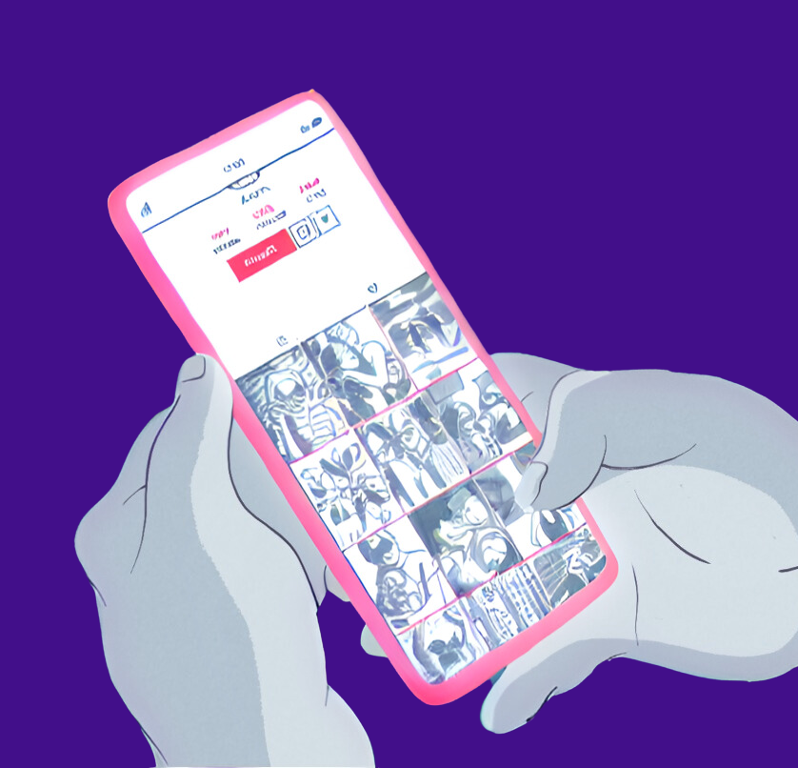
Lessons we’ve learend
(so far)
”boys don’t seek support”
Build trust – before and during support
We gave support – they wanted quick fixes
Ask first. They are super competent and experts of their own lifes.
Notes:
Boys do seek support. But not always in constructive ways. They go to strong role models that fill the masculinity norm and all of the time have all of the answers. They also seek support in sex education and body questions from porn for example. Which can be harmful – and degrading. But we reproduced that idea for a long time.
So fifteen years ago. We hung up the ”Open” sign, posted an add in the newspaper. Our volunteers sat eager by their computers. Nobody came. Why should they. They didn’t trust us. Hey they didn’t even know we existed. So we needed to be where where they are. So – and listen to this – we asked them: Where do you hang out? Thay told us and since then we have presence where they are.
Another thing that we have been struggling with is fixing or even helping them – or just give them support to start doing that journey on their own. But that’s not an easy task either.
Again – they are competent.

Slide 9
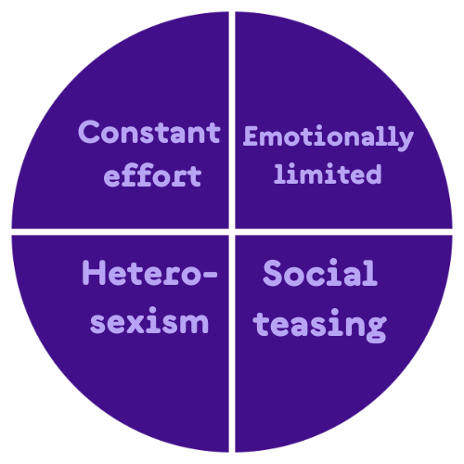
Kropp och snopp
Killnormer
Psykisk ohälsa
Relationer
Porr och sex
Våld
Source: Oransky & Fischer
Notes:
THIS IS WHAT ALL BOYS HAS TO RELATE TO. Maybe not all live by it. But they sure has to relate to it.
Always showing strength and toughnes
Emotionally limitation ragarding own and others feelings
Categoricaly avoiding and denouncing feminity and homosexiuality
Enduring pain and teasing and expected to be a part of it.
Boys and young men’s relationships are often built on competition

Slide 10
Notes:
A brief look at where we are now and where we are going.
This is our peer to peer support

Slide 11
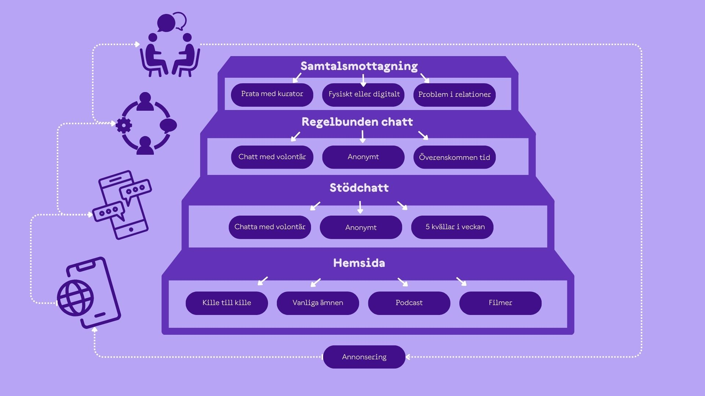
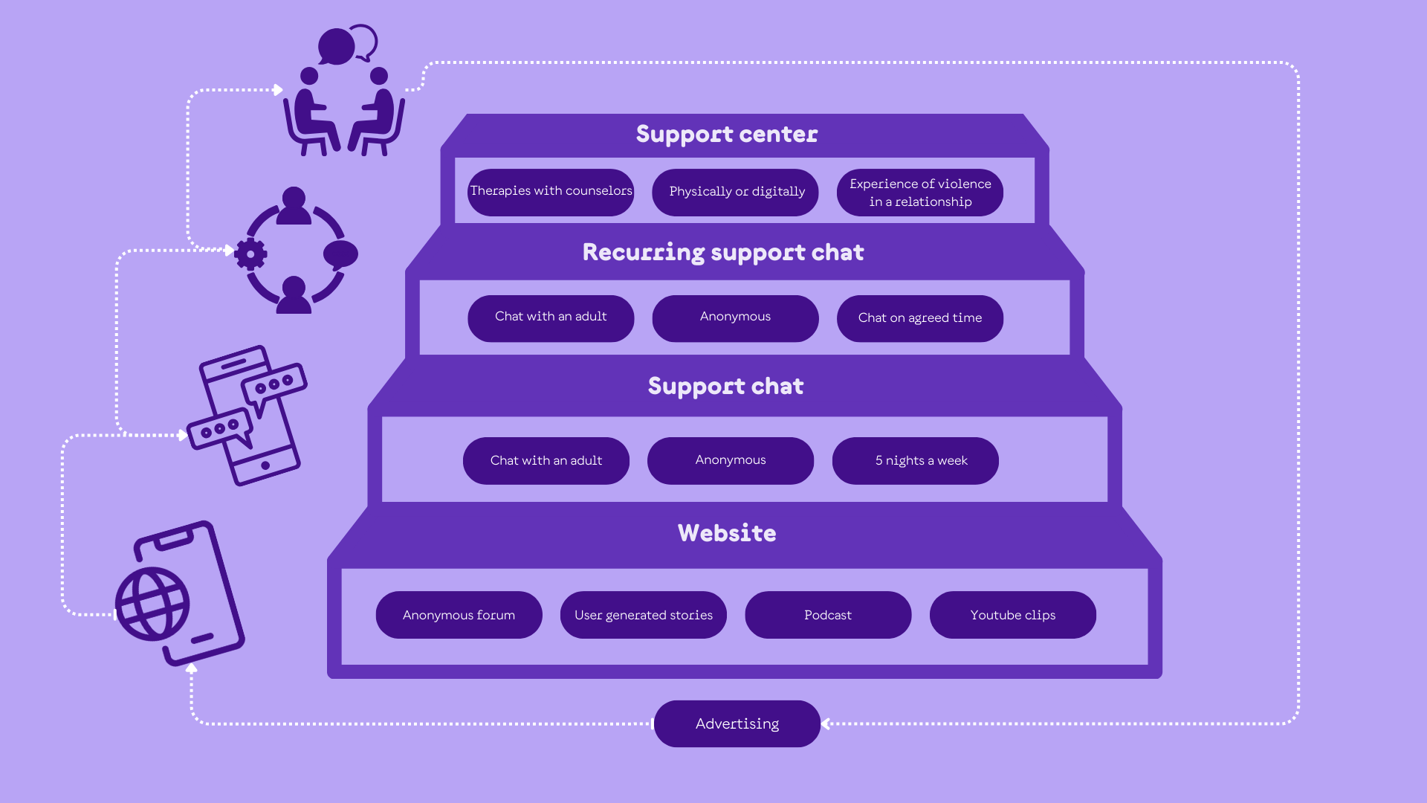
Vad erbjuder Killar.se?
Våra stödfunktioner:
Information och berättelser
Filmer och poddar
Anonymt forum ”Kille till kille”
Anonym stödchatt
Anonym, regelbunden chattkontakt
Samtalsmottagning, fysiskt och digitalt
Notes:
Adverts – events –
This is all good and well. But it has it’s limitations.

Slide 12
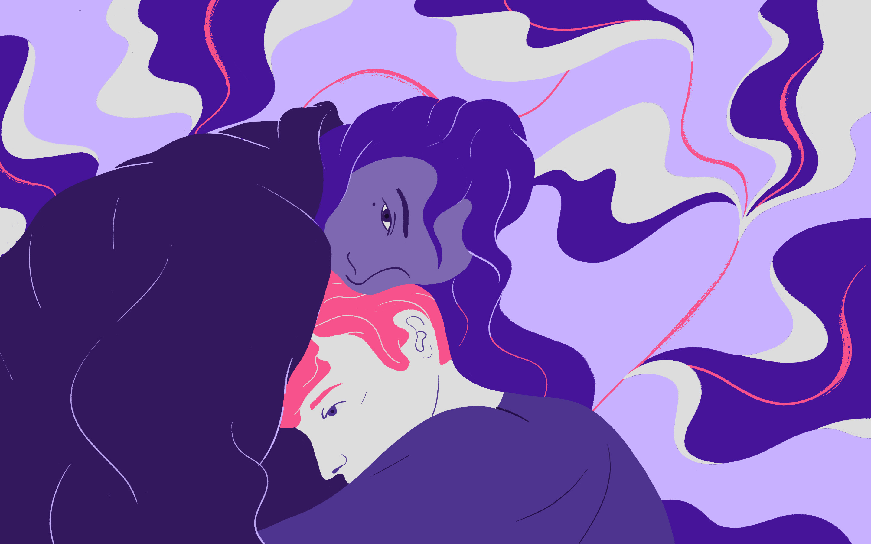
Exploring their arenas
Chain of support 2.0:
Challange the role of the support seeker
Working also at their arenas – interests
Pro-social -> social pro
Notes:
We now aim to engage more boys and young men around Killar.se. The embryo was Kille till Kille. The platform is now for boys both giving and recieving support. And we we think we can take that even a bit further. We’ve learned – surprice - boys in their teens arent super comfortable with identifying as someone in need of support. So we are now trying to gear away from that.
Now we will, together with our target group – we have employed a couple of 19-22 year old guys to start working on their arenas. Mainly online gaming at the moment – but also around sports, music and some others.
Together we will create a comunity for with and by boys. Making them social pro’s

Slide 13
Pappor.se
Fathers' groups
Separated fathers
Online/offline support community
Notes:
For 20 years we have running fathers groups. Now copying the lessons from Killar.se we have created a platform for fathers. With dedicated support for fathers in separation. With grit and dedication we will reach our targets in 3-5 years.

Slide 14
THANK YOU FOR LISTENING!
Questions?
Martin Odh
HEAD OF PSYCHOSOCIAL SUPPORT

