Slide 1

Family Matching
Best Practices for Matching Foster Families with Children
Dr. Julie Cooper

Slide 2

why matching matters
Not just a bed, but a healing relationship
Right match = stability, safety, and healing
Wrong match = risk of disruption, retraumatization

Slide 3

a “nice” family isn’t enough
Trauma
Affects trust, behavior, learning, and relationships
children
Often test caregivers’ consistency and safety
healing
Takes time with stable, supportive families

Slide 4
trauma-informed principles for matching
Physical & Emotional Safety
Voice & Choice
Cultural Identity & Connection
Trust & Transparency
Support & Collaboration

Slide 5


child assessment
Holistic View
Identify
Highlight
Physical
Emotional
Social
Educational
Cultural
Needs
Triggers
Coping Skills
Resilience
Strengths
Interests

Slide 6
table discussion
Thinking about the children you serve in your context — whether that’s through policy, direct care, education, health, or supervision — what factors do you think are most important to consider in creating a good family match? What makes matching difficult in your setting?

Slide 7
family assessment - 8 goals
1
To determine applicant motivation
2
To evaluate family and other relationships
3
To catalogue positive and negative parenting abilities
4
To screen for mental health disorders

Slide 8
family assessment - 8 goals
5
To screen for financial stability
6
To screen for health issues
7
To screen for home safety
8
To assess willingness to learn

Slide 9
key matching dimensions
Age and gender
Sibling groups
Health/therapeutic needs
Cultural & language identity
Openness to birth family contact

Slide 10

practical best practices
Share complete information (no surprises)
Prepare families with training in advance
Use gradual introductions (visits, calls, weekends)
Provide support from Day One

Slide 11

ongoing monitoring
Schedule frequent check-ins for the early weeks
Support the entire family
Adjust support as needs change
See placement as a process, not a one-time event

Slide 12
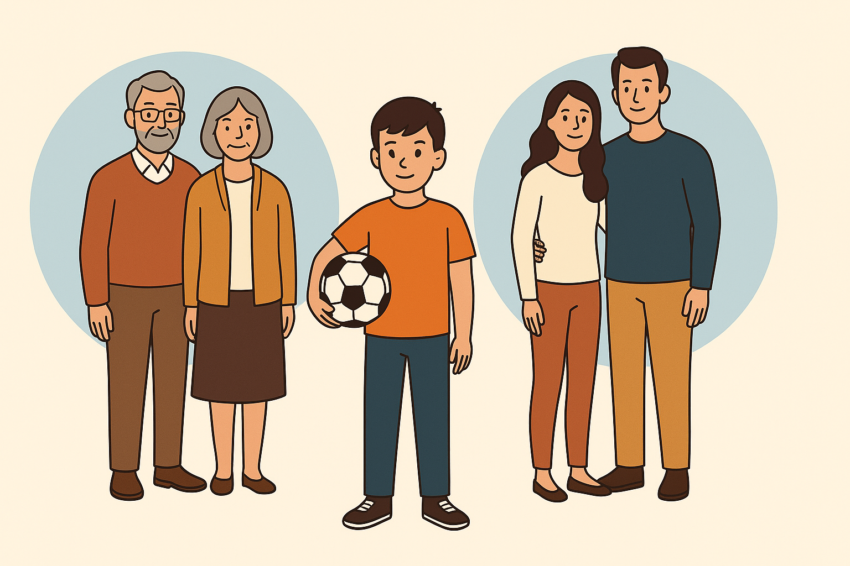
case example

Slide 13
key takeaways
1
Matching = building healing relationships
2
Seek to deeply understand both the child/ren and family
3
Include the child’s identity and voice
4
Support families continuously

Slide 14
THANK
YOU!

