Slide 1

Trauma-Informed Care
Best Practices in Homes
and Systems
Dr. Julie Cooper

Slide 2
WHAT IS TRAUMA?
Any negative event or
experience that
overwhelms
a person’s
capacity to cope.
Cope = Deal Successfully With

Slide 3
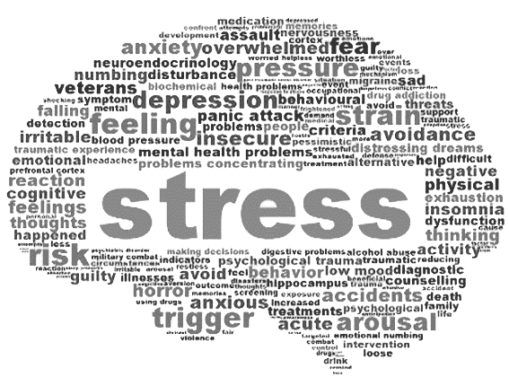
A CHILD’S REALITY
Toxic Stress

Slide 4
TOXIC STRESS
NEED
FOOD
SAFETY
COMFORT
CONNECTION
INHIBITORY
HORMONES
BODY AND
BRAIN RELAX
HYPER-
AROUSAL
EXCITATORY
HORMONES
GET FED
PROTECTED
SNUGGLED
RELATIONSHIP
RESPONSE

Slide 5
THE IMPACT OF TRAUMA
Brain
1

Slide 6

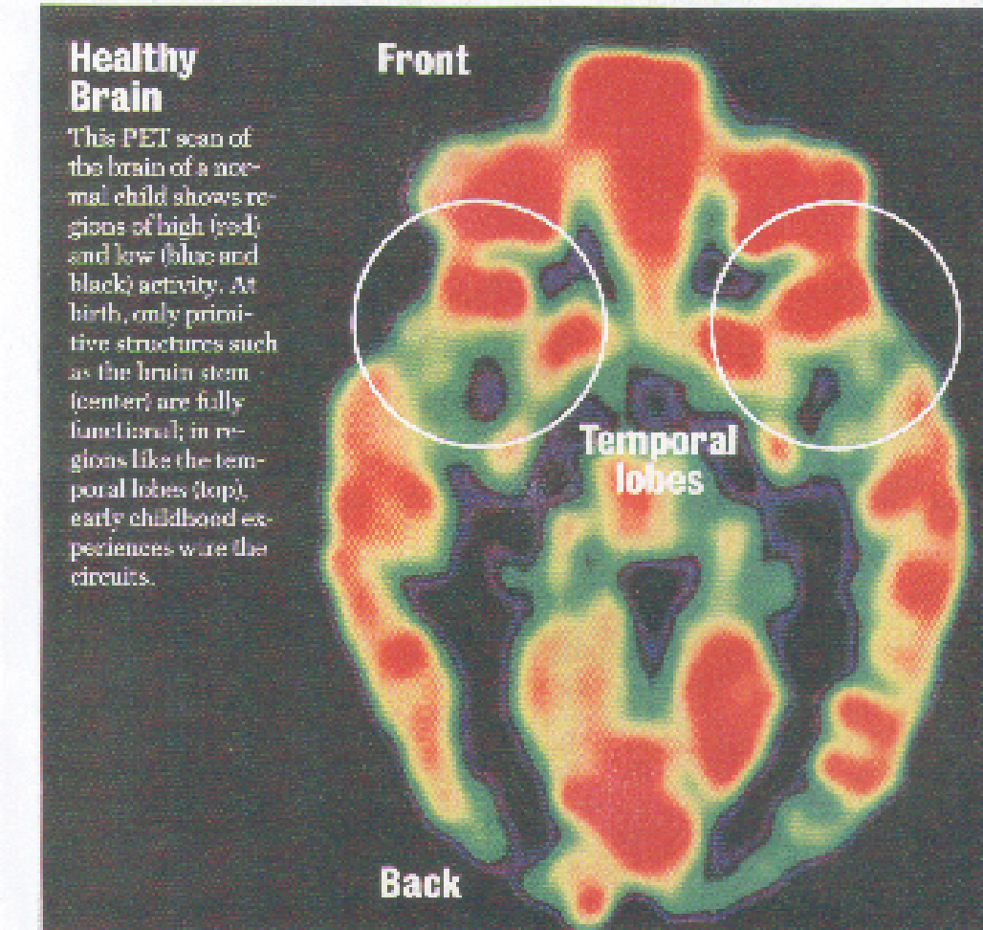
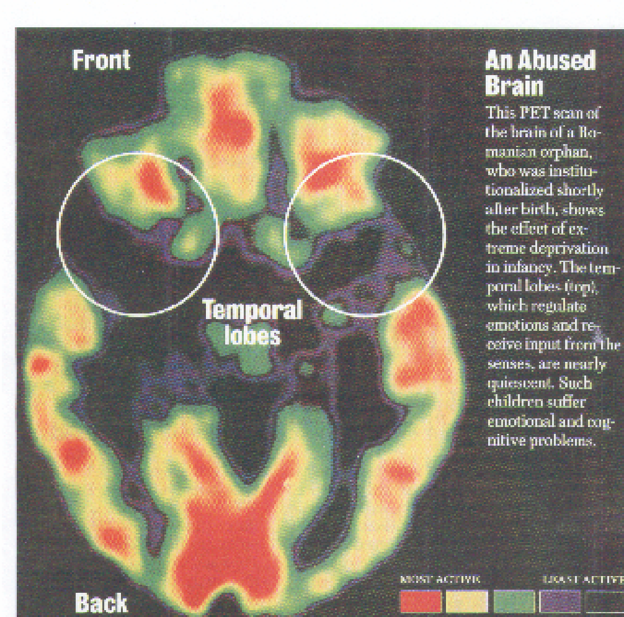
THE BRAIN AND TOXIC STRESS
CALM
FEAR

Slide 7







STUCK IN FEAR - THE NEW NORMAL
OVER-RESPONSIVE
UNDER-SELECTIVE

Slide 8
Working Memory
Flexible Thinking
Self-Monitoring
Executive
Functions
Emotional Control
Planning and Prioritizing
Impulse Control
Task Initiation
Organization

Slide 9
MAXIMIZING SAFETY
SUPPORT HEALTHY BODY AND BRAIN NEEDS
PROVIDE PREDICTABILITY
USE SAFE TOUCH
PREPARE THE CHILD FOR TRANSITIONS
MAKE IT SAFE TO TALK
MAINTAIN CONNECTION ABOVE ALL ELSE

Slide 10
THE IMPACT OF TRAUMA
Behavior
2

Slide 11
SELF REGULATION
Behavior
Self-regulation is the ability to control your behavior, emotions, and thoughts in the pursuit of long-term goals.
The skill to calm yourself, by yourself
2

Slide 12
RELATIONAL CAPACITY - DIFFICULTY TRUSTING
Behavior
2
Are you a
or a

Slide 13


PROTECTIVE STRATEGIES - I CANNOT TRUST YOU
1
2
3
4
5
6
MANIPULATION
TRIANGULATION
LYING
AGGRESSION
VIOLENCE
CONTROL
I HAVE TO TAKE CARE OF MYSELF

Slide 14
RELATIONAL CAPACITY - DIFFICULTY TRUSTING
1. Unwilling to risk - defensive detachment
2. Dysregulated and maladaptive behaviors drive people away
Behavior
2

Slide 15
THE IMPACT OF TRAUMA
Systems
3

Slide 16
PRINCIPLES OF A TRAUMA-INFORMED SYSTEM
Safety
Collaboration
Trust & Transparency
Empowerment
Voice & Choice
Cultural Connections

Slide 17
BEST PRACTICES ACROSS SYSTEMS
FOR POLICY AND LEADERSHIP (GOVERNMENT, SUPERVISORS):
Build systems that prioritize stability over speed
Require cross-sector collaboration
Invest in training and support for staff & families

Slide 18
BEST PRACTICES ACROSS SYSTEMS
FOR PRACTITIONERS (SOCIAL WORKERS, NGOS, DIRECT CAREGIVERS):
Start with listening, not labelling
Build predictability like routines and clear expectations
Respond
to behavior as
communication,
not defiance

Slide 19
BEST PRACTICES ACROSS SYSTEMS
FOR CROSS-SYSTEMS (SCHOOLS, HEALTH, LAW ENFORCEMENT):
Use consistent trauma-sensitive responses
Keep the child’s dignity at the center in every interaction.
Partner with child welfare, don’t work in silos

Slide 20
THANK
YOU!

