Slide 1



AVEKKI method
15th May 2026

Slide 2
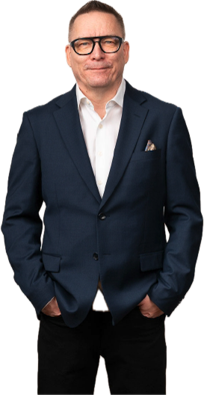
Timo Heiskala
CEO @ Autism Foundation Finland
EMBA, Certified Board Member
Vice President @ European Platform for Rehabilitation
Council of Administration @ Autism Europe
KEYNOTE SPEAKER

Slide 3
General facts

Slide 4
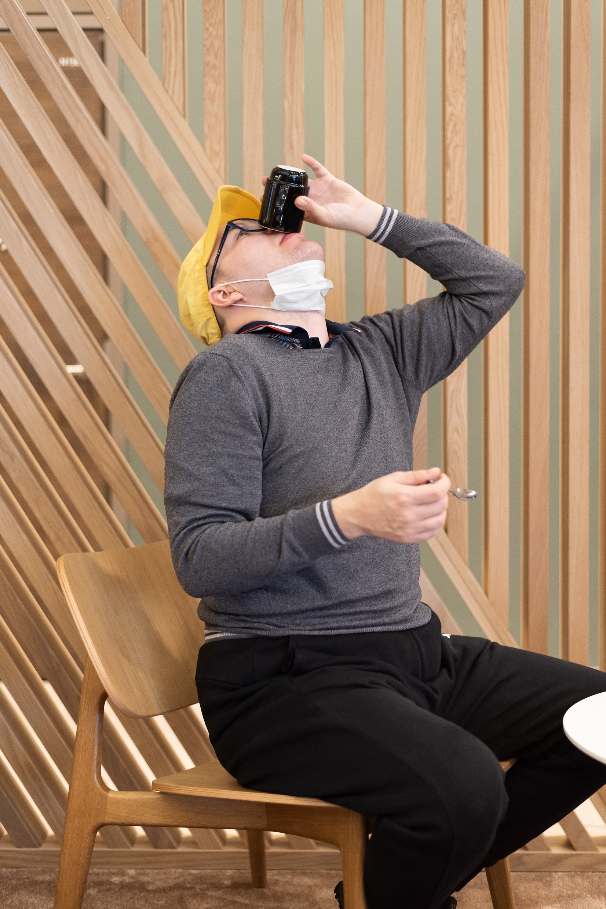

Uniquely ordinary everyday life

Slide 5


Autism Foundation Finland
Established 1998 by relatives of people on the spectrum
Not for profit Finnish Social Enterprise & holder of Finnish Key Flag

Slide 6
Key Figures 2026
Staff: over 600 proud professionals
30 locations throughout Finland
Group homes, supported living, daily activities
We own over 60 flats: rented to people who need support
Over 1,400 individual clients and we are aiming to serve even more
Turnover 25 M€ (2022),
29 M€ (2023)
37 M€ (2024)
44 M€ (2025)
47 M€ (2026 predicted)

Slide 7

Our first acquisition (April 2026):
A child protective services company called Sarastuskoti

Slide 8


Our services I
Homes
  Round-the-clock housing
  Supported living
  Coaching for independent living
  We acquire flats for our service users, currently we own 60+ flats

Slide 9
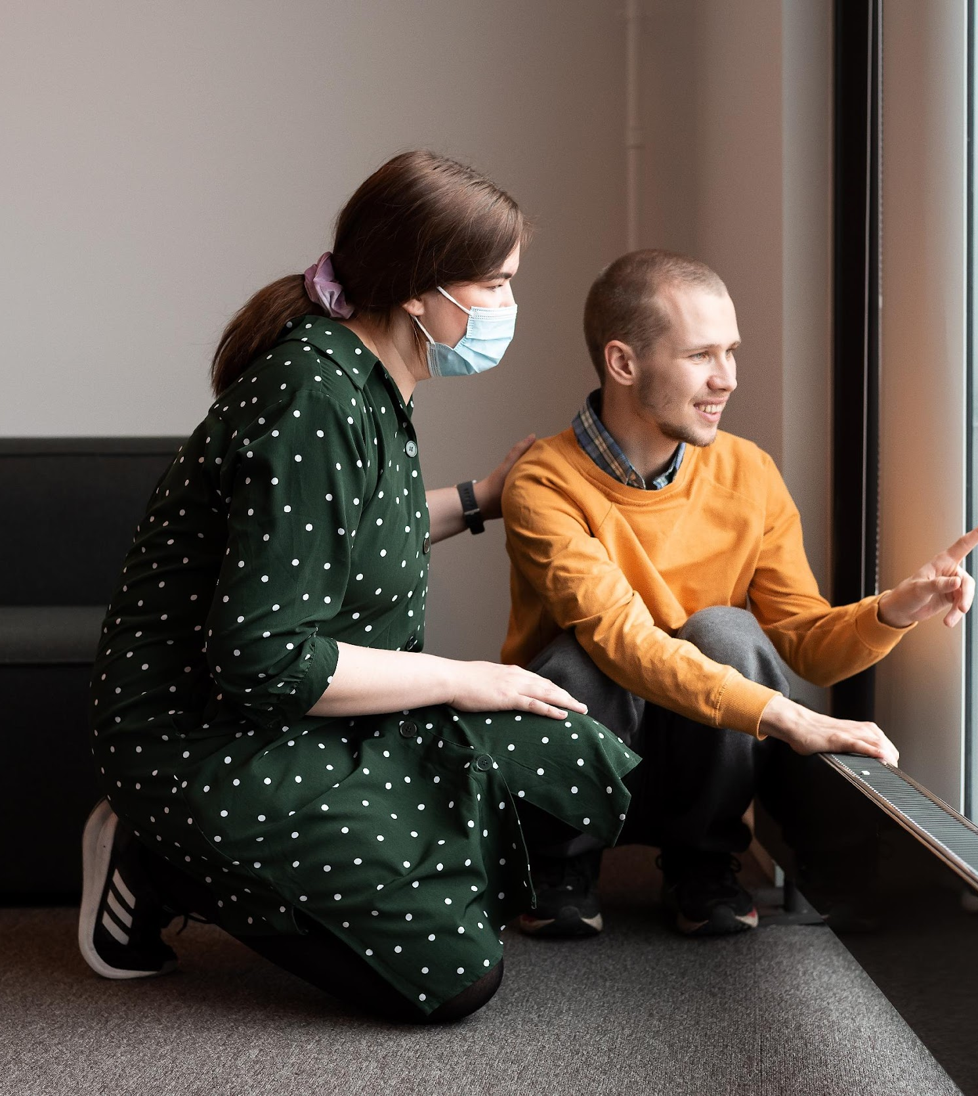
Our services II
Coaching and guidance
  Inclusive daily activities
  Employment promotion
  Neuropsychiatric coaching
  Individual coaching
  Autism guidance for families
  ACT –brief councelling
  Job coaching
  Professional support person service activities
  Group coaching

Slide 10
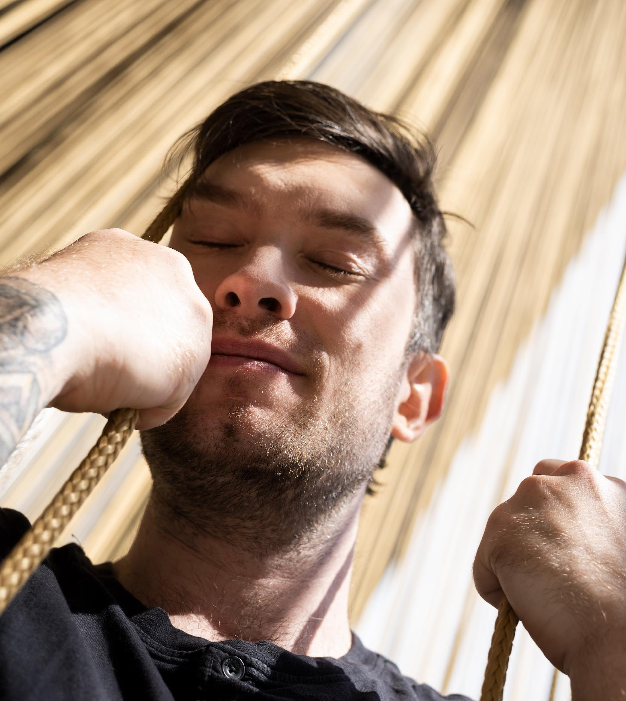
Our services III
Social insurance institution services (Kela)
  ”Own Path”–rehabilitation
Other
  Social pedagogic horse activities
  Animal assisted activities
  Sexual counseling and therapy

Slide 11
Service Class | Level of Support Need | Typical Client Profile
1 | Low support needs | The client manages fairly independently and mainly requires guidance in daily life management, errands, or social situations.
2 | Regular support needs | The client requires daily guidance in several areas of life but does not need continuous supervision.
3 | High support needs | The client requires substantial assistance in daily activities, structured support, and active staff presence.
4 | Very high / intensive support needs | The client requires continuous guidance, supervision, or care. This may include challenging behaviour, communication difficulties, or significant functional limitations.
5 | Highest level of specialized support | Around-the-clock, highly intensive, multidisciplinary support. Often includes severe neuropsychiatric, psychological, or complex medical support needs.

Slide 12

The AVEKKI method
A practical approach to preventing and managing challenging situations in social care
Focus on safety, dignity, and understanding
Applicable across all client groups
Widely used in Finnish social and healthcare services
Developed by Savonia university of applied sciences
Autism Foundation Finland has a license to train

Slide 13

What is AVEKKI?
A structured approach to:
  Prevent escalation
  Understand behaviour
  Ensure safety
Based on:
  Human rights
  Trauma-informed care
  Professional reflection
Key idea: Behaviour always has a reason

Slide 14

Who can use AVEKKI
Residential care staff
Disability services professionals
Mental health workers
Child protection staff
Elderly care professionals
Educators and support staff
Works across all service environments

Slide 15

When applicable?
Anxiety or distress situations
Communication breakdowns
Sensory overload
Trauma responses
Aggressive or self-harming behaviour
Not limited to autism – applicable to all client groups

Slide 16
Core principles
Prevention first!
Respect and dignity
Professional self-control
Teamwork and shared responsibility

Slide 17
AVEKKI learning content
1. Prevention
Recognising triggers
Early warning signs
2. Interaction
Calm communication
De-escalation skills
3. Intervention
Safe, minimal physical intervention (last resort)
Team coordination

Slide 18

Practical example : A child
Situation:
Child becomes agitated and refuses instructions
AVEKKI approach:
Reduce demands
Use calm tone
Offer choices
Outcome:
Situation de-escalates without conflict

Slide 19

Practical example: An adult
Situation:
Adult becomes verbally aggressive
AVEKKI approach:
Maintain distance
Avoid power struggle
Acknowledge emotions
Outcome:
Trust preserved, escalation avoided

Slide 20

Practical example: An elderly person
Situation:
Person with dementia resists care
AVEKKI approach:
Understand fear/confusion
Adjust timing and method
Use reassurance
Outcome:
Care delivered with dignity

Slide 21
High risk situations
Physical intervention only if necessary
Must be:
  Proportionate
  Minimal
  Time-limited
Always stop when risk decreases

Slide 22

Legal framework (Finland)
Key principles:
Necessity
Proportionality
Last resort
Respect for dignity
Actions must have legal basis
Incidents must be documented and reported to authorities
Staff must be trained and competent

Slide 23

In conclusion
AVEKKI is preventive, not reactive
Works across all client groups
Focus on understanding behaviour
Physical intervention is rare
Communication is the most powerful tool

Slide 24

Thank you for your interest
Questions & comments are more than welcome!

